Slide 1

IBM Services

Slide 2
Natural language processing overview

Slide 3
What is natural language processing
NLP is the study of the computational treatment of natural (human) language.
It enables machines to understand human communication to extract different information.
Examples of NLP applications: Analysis of text in emails, human speech, social media, or documents.
NLP has its origins in machine translation from the 1950s.
NLP advanced over the years by combining the power of artificial intelligence (AI), computational linguistics, and computer science.
Notes:
NLP stands for natural language processing. It is a subfield of computer science and AI concerned with the processing human language by computers. It is one of the most important fields in computer science in both industry and academia.
NLP enables machines to understand human communication to extract different information.
Examples of NLP applications include analysis of text in emails, human speech, social media, or documents.
NLP has its origins in machine translation from the 1950s.
The first machine translation was from English to Russian and vice versa, but with poor and inaccurate results.
Machine translation and other NLP applications advanced over the years by combining the power of artificial intelligence (AI), computational linguistics, and computer science.

Slide 4
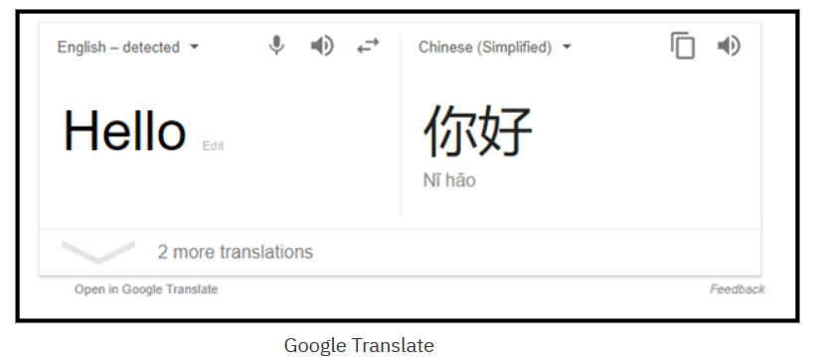
Natural language processing applications
Machine translation
Information retrieval: Search engines
Spell checkers
Natural language assistants
Notes:
Here are the most popular NLP tasks:
Machine translation: Automatically translating one language to another
Information retrieval: Search engines, such as Google and Bing
Spell checkers
Natural language assistants, such as Siri and Alexa

Slide 5
Natural language processing challenges
Domains: Higher accuracy for specific domains compared to generic domains.
Language: English gets the most attention because it is an international language.
Medium: Processing speech is more difficult than processing text.
You can understand your NLP problem by focusing on the following areas:
Become familiar with your data.
Understand the challenges of your particular use case.
Review the state-of-the-art solutions and technologies for similar problems.
Notes:
There are always some challenges that need to be tackled for any case. In NLP, here are the most popular challenges:
Domains: Higher accuracy for specific domains compared to generic domains.
Language: English gets the most attention because it is an international language.
Medium: Processing speech is more difficult than processing text.
To resolve some of these challenges, you must become familiar with your data and understand the challenges of your particular use case. Think about how you will acquire the data and how to validate its quality. Think about the deployment of your solution and how you are planning to cover all these points.
Finally, review the state-of-the-art solutions and technologies for similar problems and how these issues were resolved.
References:
Course hero
https://www.coursehero.com/file/p3q1s78/Language-English-gets-the-most-attention-because-it-is-an-international-language/

Slide 6
Natural language processing use cases

Slide 7
Natural language processing use cases
Information extraction
Goal: Parse the input text to extract valuable output.
Examples: Entity extraction, relation identification extraction, text summarization
Unstructured text: Dynamic structure (for example emails, newspaper articles, and user reviews).
Parse unstructured text, identify important mentions and their relations, and extract valuable output into structured text (defined structure).
Text summarization
Goal: Shorten or summarize long pieces of text.
Notes:
NLP technology can be used to extract information from unstructured text such as emails, newspaper articles, and user reviews into structured text.
Entity extraction refers to extracting entities from the text such as organizations, people, and locations. For example, the World Health Organization, IBM, Sara, John, Paris, US.
Relation extraction refers to identifying the relationship between entities, for example, “Abraham Lincoln was a US president”; “Ginni Rometty is the CEO of IBM”.
Text summarization refers to the technique of shortening long pieces of text. Automatic text summarization is a common use case in machine learning and natural language processing.
Structured text mostly takes the form of tables or values in a structured form.
The goal of information extraction is to parse the incoming text, identify important mentions and their relations, and extract valuable output into structured text. Doing so can be used to automate the process of reading articles and passages to convert this information into a structured format. Computer systems can then manage this information and take proper actions.

Slide 8
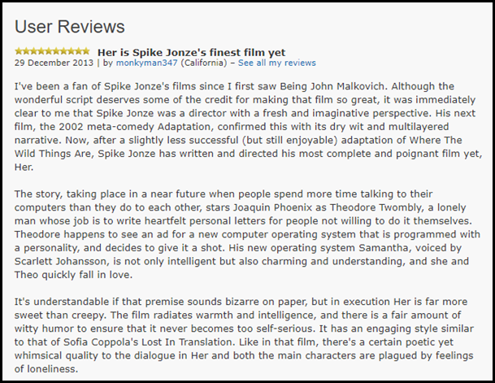
Natural language processing use cases (cont.)
Sentiment analysis
The process of identifying emotions or opinions that are expressed in user input.
This analysis is used in marketing, retention plans, and emotional intelligence for chatbots.
Notes:
Sentiment analysis is the process of identifying emotions or opinions that are expressed in user input.
Sentiment analysis answers various questions, such as how people feel about your product or whether your customers are satisfied with your customer service.
It is used in marketing and retention plans, and emotional intelligence for chatbots, that is, it enables chatbots to direct the conversation.
Machine learning algorithms brought many advances to this field and are still improving.

Slide 9
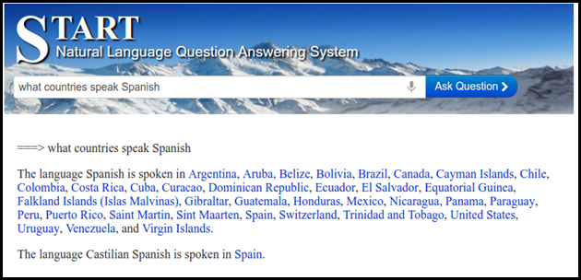
Natural language processing use cases (cont.)
Question and answering
Builds solutions that can answer questions that are asked by humans in natural language.
Examples: Natural language questions used to retrieve answers from forums; FAQ application; chatbots
Speech recognition
Converts spoken language into text.
Example: Chatbot interactive talk; Internet of Things (IoT) applications
Notes:
Question and answering
Building solutions that can answer questions that are asked by humans in natural language. A question and answering system can be used for the following tasks:
Retrieving answers from forums.
Building a Frequently Asked Questions (FAQs) system.
Training chatbots
Speech recognition is another use case that helps to advance the capabilities of many different applications. It converts spoken language into text. It can be used in many applications in several domains, such as having an interactive talk with a chatbot. It can also be used in Internet of Things (IoT) applications.

Slide 10
Natural language processing basic concepts and terminology
Notes:
This section introduces basic concepts and terminologies such as synonymy, polysemy, hyponymy, and hypernymy. The taxonomy for similar concepts has applications in the education and machine learning fields because they rely on word-sense disambiguation.

Slide 11
Basic concepts and terminologies
Synonyms: Words that are written differently but are similar in meaning.
Example: Clever and smart
Antonyms: Words that have meanings that are opposite to each other.
Example: Clever and stupid
Usage example: In information retrieval, you might want to expand the keywords search by retrieving the synonyms of the query words.
Notes:
Synonyms are words that are written differently but are similar in meaning. For example:
Clever and smart
Begin and start
Beautiful and pretty
Sad and unhappy
Antonyms are words that have meanings that are opposite to each other. For example:
Clever and stupid
Begin and end
Beautiful and ugly
Sad and happy
Usage example: In information retrieval, you might want to expand the keywords search by retrieving the synonyms of the query words.

Slide 12
Basic concepts and terminologies (cont.)
Homonyms: Words that have the same written form but have unrelated meanings. There are two types of homonyms:
Homographs: Words that have the same written form. For example:
This answer is right.
The building is on the right side of the river.
You have the right to remain silent.
Come here right now.
Homophones: Words that sound similar when spoken but have different meanings and spellings. For example:
“left” and “lift”.
“right” and “write”.
Notes:
Homonyms are words that have the same written form but have unrelated meanings. There are two types of homonyms:
Homographs
Homophones
Homographs are words that have the same written form. For example:
This answer is right.
The building is on the right side of the river.
You have the right to remain silent.
Come here right now.
Although the word right has the same written form in the examples, you notice the difference between the meanings in each sentence.
Homophones are words that sound similar when spoken but have different meanings and spellings. For example:
“left” and “lift”.
“right” and “write”.

Slide 13
Basic concepts and terminologies (cont.)
Homonyms challenges:
How do you translate “right” so that it has the correct meaning?
How do you differentiate two words that sound similar when you convert speech to text?
Notes:
Homonyms introduce challenges into NLP operations such as machine translation and speech recognition. How do you translate right so that it has the correct meaning? How do you differentiate two words that sound similar when you convert speech to text?

Slide 14
Basic concepts and terminologies (cont.)
Polysemy: Words that have the same written form and a related meaning. For example:
You must face your fear.
Her face is beautiful.
Hyponymy: A word is a hyponym of another word if it represents a subclass of the other word. For example:
Orange is a hyponym of fruit.
Yellow is a hyponym of color.
Notes:
Polysemy refers to words that have the same written form and related meaning. For example:
You must face your fear.
Her face is beautiful.
Hyponymy: A word is a hyponym of another word if it represents a subclass of the other word. For example:
Orange is a hyponym of fruit.
Yellow is a hyponym of color.

Slide 15
Basic concepts and terminologies (cont.)
Hypernymy: One word is the hypernym of another word if it represents a superclass of the other word. For example:
Fruit is a hypernym of orange.
Color is a hypernym of yellow.
Usage example: Comparing the semantic similarity.
Notes:
Hypernymy: One word is the hypernym of another word if it represents a superclass of the other word. For example:
Fruit is a hypernym of orange.
Color is a hypernym of yellow.
Usage example: Comparing the semantic similarity.

Slide 16
Natural language processing tools and services

Slide 17
Natural language processing tools and services
Open-source NLP tools:
Apache OpenNLP: Provides tokenizers, sentence segmentation, part-of-speech tagging, named entity extraction, chunking, parsing, co-reference resolution, and more.
Stanford Core NLP: A suite of NLP tools that provide part-of-speech tagging, a named entity recognizer, a co-reference resolution system, sentiment analysis, and more.
Natural Language Toolkit (NLTK): A Python library that provides modules for processing text, classifying, tokenizing, stemming, tagging, parsing, and more.
WordNet: One of the most popular lexical databases for the English language. Supported by various API and programming languages.
Notes:
There are many open source tools that you can use for NLP. For example:
Open NLP that is based on Java. It provides many functions for text processing, such as tokenizers, sentence segmentation, part-of-speech tagging, named entity extraction, chunking, parsing, co-reference resolution, and more. For more information, see Apache OpenNLP at https://opennlp.apache.org/
Stanford Core NLP, which is written in Java. It is a suite of NLP tools that provide part-of-speech tagging, a named entity recognizer, a co-reference resolution system, sentiment analysis, and more. It supports many languages, such as English, German, French, Arabic, Spanish, and Chinese. For more information, see https://stanfordnlp.github.io/CoreNLP/.
NLTK provides the same processes as the other NLP suites, but in the Python language. For more information, see https://www.nltk.org/.
WordNet is a popular lexical database that is used in research. There are many APIs and languages that you can use to access WordNet. For example, you can make a call to retrieve a synonym of a word. WordNet is available online and as an offline version that you can download. For more information, see https://wordnet.princeton.edu/.
There are other libraries, such as Unstructured Information Management Architecture (UIMA). IBM Watson uses UIMA to analyze unstructured data. The Apache Clinical Text Analysis and Knowledge Extraction System (Apache cTAKES) is a UIMA-based system that is used to extract information from medical records.
References:
Apache OpenNLP
https://opennlp.apache.org/
CoreNLP
https://stanfordnlp.github.io/CoreNLP/

Slide 18
Natural language processing tools and services (cont.)
Services:
Examples: IBM Cloud, Microsoft Cloud (Azure), and Google Cloud
IBM offers AI services through IBM Cloud.
Examples of NLP services are:
Watson Natural Language Understanding for text classification, entity identification, relation extraction, and emotion extraction.
Language Translator: Translates text from one language to another.
Watson Assistant: build conversational interface into an application (chatbot).
Notes:
Instead of using low-level libraries, you can use many cloud services that accomplish high-level NLP tasks, for example, IBM Cloud, Microsoft Cloud (Azure), and Google Cloud.
IBM offers its AI services through IBM Cloud.
Examples of NLP services are:
Watson Natural Language Understanding for text classification, entity identification, relation extraction, and emotion extraction.
Language Translator: Translates text from one language to another
Watson Assistant: build conversational interface into an application (chatbot).
You can rapidly build a complete NLP application by using these services.

Slide 19
Natural language processing categories

Slide 20
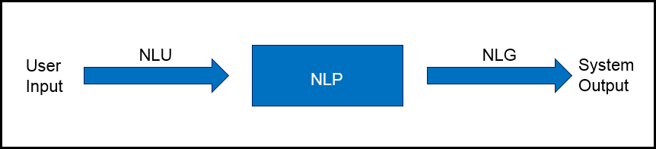
Natural language processing categories
Natural language understanding (NLU)
Natural language generation (NLG)
Notes:
There are two categories of NLP:
Natural language understanding (NLU): It is the NLP task of extracting insights from natural language inputs.
Natural language generation (NLG): it is the NLP task of building natural language outputs from non-linguistic inputs.
Natural language exists in various media, such as text in documents, reports, or messages, or speech.
The graphic in the slide shows that NLU is the NLP process that takes input text while NLG is the NLP process that generates text as output.

Slide 21
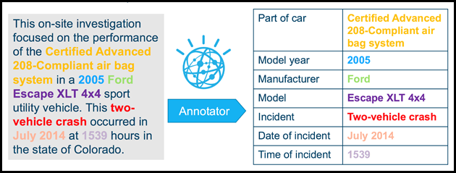
NLU applications
Unstructured to structured
Question and answer system
Sentiment analysis
Notes:
NLU analyzes language to gain insights into the text. There are many examples of NLU applications:
Mapping a user’s unstructured input to a computer representation (structured data) and relation extraction
Question and answering system
Sentiment analysis
The graphic in the slide shows an example of converting unstructured to structured data. The input to the NLU system is natural language (unstructured text) and through the NLP process it is converted to structured data (table).
References:
Natural Language Generation: An Overview
http://www.lacsc.org/papers/PaperA6.pdf
Understanding Natural Language Understanding
https://nlp.stanford.edu/~wcmac/papers/20140716-UNLU.pdf

Slide 22
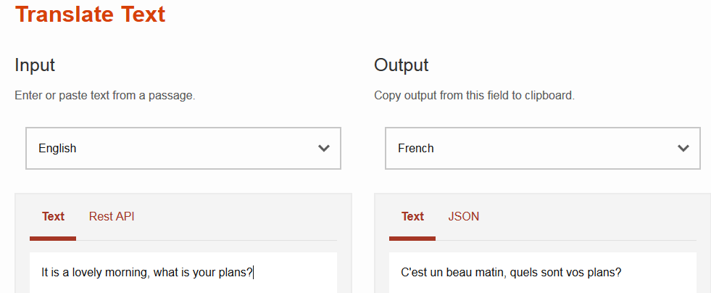
NLG applications
Machine translation
Text summarization
Weather forecasting system
Notes:
Here are some NLG application examples:
Translator.
Text summarization.
Weather Forecasting Systems, which compile graphical weather maps representations and interpret the numbers that come from the prediction system. By using NLG, you can transform this information into natural language.
References:
Watson Language Translator
https://www.ibm.com/cloud/watson-language-translator
Natural Language GenerationScope, Applications and Approaches
http://www.academia.edu/3879518/Natural_Language_Generation_Scope_Applications_and_Approaches

Slide 23
Language ambiguities

Slide 24
Language ambiguities
Lexical ambiguity: A primitive level, such as at the word level
Verb versus noun:
“We will dance all night.”
“This is the salsa dance.”
“John will go to work.”
“His uncle left him millions in his will.”
Notes:
Building applications with NLP processes is not a trivial task. Natural language includes many ambiguities, such as a lexical ambiguity, which is a primitive level, such as at the word level.
Two examples:
The word dance can be a verb (“We will dance all night.”) or a noun (“This is the salsa dance.”).
The word will can be a helping verb to indicate an action in the future (“John will go to work”) or a noun (“His uncle left him millions in his will.”).

Slide 25
Language ambiguities (cont.)
Syntactic-level ambiguity: A sentence that can be parsed in various ways.
Example: “She pointed at the guy with the umbrella.”
Anaphora ambiguity occurs when it is not clear which one is the antecedent noun that a pronoun replaces because more than one possible antecedent exists.
Example: “When Mary invited Ann to play, she did not know that she would be late”.
Notes:
Here are two more types of language ambiguity:
Syntactic-level ambiguity: A sentence that can be parsed in various ways. For example: “She pointed at the guy with the umbrella.” Did she use her umbrella to point at the guy or did she point at the guy who is carrying an umbrella?
Anaphora is an expression for which the interpretation depends on another expression that was previously introduced. The referring term is called anaphor and it is usually a pronoun. The pronoun takes the place of a noun but, to avoid ambiguity, the pronoun must refer clearly to the noun that the pronoun replaces.
An anaphora ambiguity occurs when more than one possible antecedent exists. For example: “When Mary invited Ann to play she did not know that she would be late.” Is the first “she” replacing Mary or Ann? Who did not know? Is the second “she” replacing Mary or Ann? Who would be late?
References:
Syntactic ambiguity
https://en.wikipedia.org/wiki/Syntactic_ambiguity
Anaphora (linguistics)
https://en.wikipedia.org/wiki/Anaphora_(linguistics)

Slide 26
Natural language processing phases and pipeline

Slide 27
Natural language processing phases
Morphological Analysis/ Lexical Analysis
Breaks down the text paragraphs, sentences, and words.
Syntactic Analysis
Semantic Analysis
Extracts meaningful information from the text.
Analysis is done for identification and description of the structure of words.
Rejects and ignores the sentences that do not make sense.
Discourse Integration
Helps in studying the whole text.
Pragmatic Analysis
Interprets the text by using information from the previous steps.
Understands the communicative and social content.
Studies the underlying meaning of a spoken or written text as it considers the social and historical contexts.
Checks grammar, arrangements of words, and the relationship between the words.
Techniques used: stop word removal, tokenization, stemming, and lemmatization.
Techniques used: dependency parsing, and part of speech (POS) tagging.
Notes:
The NLP five phases or stages are:
Morphological Analysis
Morphological analysis is a field of linguistics that studies the structure of words. It identifies how a word is produced by using morphemes. The morpheme is the smallest element of a word that has grammatical function and meaning. It is a meaningful morphological unit of a language that cannot be further divided.
Also, this phase is called lexical analysis, which deals with the study at the level of words regarding their lexical meaning and part-of-speech. This level of linguistic processing uses a language's lexicon. Lexicon of a language is the collection of words and phrases in that language. The lexical analysis divides the text into paragraphs, sentences, and words. Lexical normalization, which is the process of converting or transforming a nonstandard text to a standard register, is performed. Lexical normalization includes techniques such as:
Stop word removal (removing for example ‘and’, ‘of’, ‘the’ from text)
Tokenization (breaking the text into sentences or words)
Word tokenizer
Sentence tokenizer
Tweet tokenizer
Stemming (removing ‘ing’, ‘es’, ‘s’ from the tail of the words)
Lemmatization (converting the words to their base forms)
Syntactic Analysis
Syntactic analysis is the analysis that provides the logical meaning of a sentence or parts of that sentence. It is the process of analyzing natural language with the rules of formal grammar. Grammatical rules are applied to categories and groups of words, not to individual words.
Syntactic Analysis is used to check grammar, arrangements of words, and the interrelationship between the words.
Example: “Mumbai goes to the Sara”. This sentence does not make sense, so this sentence is rejected by a syntactic analyzer.
Syntactical parsing involves the analysis of words in the sentence for grammar. Dependency grammar and part of speech (POS) tags are the important attributes of text syntactic.
Some of the techniques that are used in this phase are:
Dependency Parsing
Part of Speech (POS) tagging
Semantic Analysis
Semantic analysis retrieves the possible meanings of a sentence that is clear and semantically correct. It is the process of retrieving meaningful insights from text.
Discourse Integration
Discourse integration refers to the context of a sentence or word. The meaning of a sentence depends on the meaning of the sentence just before it. In addition, it also brings about the meaning of the immediately succeeding sentence.
For example, the word “that” in the sentence “He wanted that” depends upon the prior discourse context.
Pragmatic Analysis
Pragmatic analysis is the study of meanings in a language. In involves the process of extraction of insights from the text. Through Pragmatic Analysis, what was described is reinterpreted by what it was meant. It derives the various aspects of language that require real-world knowledge. It means to abstract the meaningful use of language in situations. In this analysis, the focus is always on what was said is reinterpreted on what is intended.
For example, the sentence “Please crack the door open” does not mean to break the door but to open it a small amount.
References:
Phases in Natural Language Processing
https://padhaitime.com/Natural-Language-Processing/Phases-in-NLP
Stages of Natural Language Processing
https://byteiota.com/stages-of-nlp/
The 5 Phases of Natural Language Processing
https://www.optisolbusiness.com/insight/the-5-phases-of-natural-language-processing
Natural Language Processing Step by Step Guide
https://www.analyticsvidhya.com/blog/2021/05/natural-language-processing-step-by-step-guide/#h2_6

Slide 28
Natural language processing pipeline
A pipeline is a way to design a program in which the output of one module feeds into the input of the next module.
Using the NLP pipeline divides the tasks of NLU, which makes NLU less complex.
For example, use NLP pipeline to understand the following sentence:
“Yes, I got the invitation, and I will happily attend your party in London.”
Notes:
When you work on an NLP task like machine translation, you must perform a set of processes and activities. This set of processes is the NLP pipeline.
A pipeline is a process for designing a program in which the output of one module feeds into the input of the next module. You use the pipeline to break down the complexity of the NLP task into a smaller set of less complicated tasks. There are no strict rules for the activities that must be done in the pipeline.
The following slides, explore some of these activities by using the following example:
“Yes, I received your invitation, and I will happily attend your party in London.”
This statement is understandable by a human but not a computer. We use the pipeline to walk through each stage to analyze the statement.
Reference:
CoreNLP Pipelines
https://stanfordnlp.github.io/CoreNLP/pipelines.html

Slide 29
Natural language processing pipeline
Sentence segmentation
Word tokenization
Stemming
Chunking
Lemmatization
Stop words removal
Dependency Parsing (DP)
Part of speech (POS) tagging
Named entity recognition (NER)
Notes:
NLP uses pipelines to read, decipher, and understand human languages. The slide shows the prime processes of the NLP pipelines.
References:
Preprocessing steps in Natural Language Processing (NLP)
https://www.educative.io/answers/preprocessing-steps-in-natural-language-processing-nlp
How to build an NLP pipeline
https://www.wikitechy.com/tutorial/nlp/how-to-build-an-nlp-pipeline

Slide 30
Natural language processing pipeline (cont.)
Sentence segmentation:
Detect sentence boundaries.
There are two sentences in the example that are separated by the conjunction “and”:
“Yes, I got the invitation, and I will happily attend your party in London.”
Apply this process to the example:
“Yes, I got the invitation.”
“I will happily attend your party in London.”
Notes:
Sentence segmentation focuses on finding the boundaries of sentences in text, that is, where the sentence starts and ends. This is not an easy task to accomplish due to the possible ambiguity that is caused by punctuation marks.
For example, a period might indicate the end of a sentence, but it might also indicate an abbreviation, a decimal point, or an email address.
Assume that the two sentences here are separated by the conjunction “and”, so the result of this stage is the following sentences:
“Yes, I received your invitation.”
“I will happily attend your party in London.”
Reference:
Sentence boundary disambiguation
https://en.wikipedia.org/wiki/Sentence_boundary_disambiguation

Slide 31
Natural language processing pipeline (cont.)
Word Tokenization:
Breaks a sentence into tokens.
Tokenization uses delimiters, for example, a space ” “.
Apply tokenization to the example:
First sentence: “Yes””,” “I” “got” “the” “invitation”
Second sentence: “I” “will” “happily” “attend” “your” “party” “in” “London”
Notes:
Tokenization is a basic process that breaks a sentence into a group of words, punctuation, numbers, and alphanumerics that are called tokens. The tokenization can be done on multiple delimiters. Assume in the example that you use the white space as delimiter and apply tokenization to the example: First sentence: “Yes””,” “I” “received” “your” “invitation” Second sentence: “I” “will” “happily” “attend” “your” “party” “in” “London”
White space is a standard delimiter but is not sufficiently useful by itself. For example, segmenting “New York” into “New” and “York” might introduce ambiguity because they both refer to a state, so you should preserve the space in-between.
┌ Note ─────────────────
Sentence segmentation, tokenization, and other activities in the pipeline might also differ depending on the language. For example, you cannot use the same English tokenizer with the Japanese language.
└────────────────────

Slide 32
Natural language processing pipeline (cont.)
Stemming:
Removes the prefixes and suffixes to obtain the root word.
The stem does not have to match the morphological root of the word. For example, “Studies” stemmed to “Studi”.
The most popular English stemming algorithm is the Porter's algorithm (Porter, 1980).
Example:
List of words: Affection, Affects, Affecting, Affected, Affecting
Root word: Affect+
Apply stemming to the example:
First sentence: “Yes””,” “I” “got” “the” “invitation”
“invitation” => “invit”
Second sentence: “I” “will” “happily” “attend” “your” “party” “in” “London”
“happily” => “happi”
Notes:
In the stemming step, the prefixes and suffixes are removed to obtain the root word.
Stemming chops words without knowing the context of the word in sentences. It might create the nonexistence meaning of a word. For Example: “Studies” => “Studi”, "troubled" => "troubl".
Stemming is preferred when the meaning of the word is not important for analysis, for example spam detection. Lemmatization is recommended when the meaning of the word is important for analysis, for example, Question & Answer system.
References:
Preprocessing steps in Natural Language Processing (NLP)
https://www.educative.io/answers/preprocessing-steps-in-natural-language-processing-nlp
What is Stemming and Lemmatization in NLP?
https://www.analyticssteps.com/blogs/what-stemming-and-lemmatization-nlp

Slide 33
Porter stemmer
Step Number | Rule | Example
1 | sses → ss ies → I ss → ss s → ø | glasses → glass parties → parti loss → loss hats → hat
2 | ing → ø ed → ø | talking → talk discovered → discover
3 | ational → ate izer → ize ator → ate | operational → operate recognizer → recognize collaborator → collaborate
4 | al → ø able → ø ate → ø | electrical → electric doable → do investigate → investing
Notes:
This table demonstrates some of the rules of the Porter stemmer.

Slide 34
Natural language processing pipeline (cont.)
Lemmatization:
Groups together different inflected forms of a word into a base word called lemma.
Example:
List of words: going, gone, went
Lemma: go
Apply lemmatization to the example:
First sentence: “Yes””,” “I” “got” “the” “invitation”
“got” => “get”
Notes:
An inflected form of a word has a changed spelling or ending that shows the way it is used in sentences: "Finds" and "found" are inflected forms of "find."
Lemmatization groups different inflected forms of a word into a base word called lemma. For example,
List of words: going, gone, went
Lemma: go
References
Preprocessing steps in Natural Language Processing (NLP)
https://www.educative.io/answers/preprocessing-steps-in-natural-language-processing-nlp
What is Stemming and Lemmatization in NLP?
https://www.analyticssteps.com/blogs/what-stemming-and-lemmatization-nlp

Slide 35
Natural language processing pipeline (cont.)
Stop words removal:
Removes a set of commonly used words that do not add much meaning to the sentence.
Allows applications to focus on the important words instead.
Example:
Removing ‘and’, ‘of’, ‘the’ from text
Apply stop word removal to the example:
First sentence: “Yes””,” “I” “got” “the” “invitation”
Removing the word “the”
Notes:
Stop words are the words in any language that do not add much meaning to a sentence. Stop words can safely be ignored without sacrificing the meaning of the sentence. For example, in English, “the”, “is” and “and”, are examples of stop words. In NLP and text mining applications, stop words removal eliminates unimportant words so that applications can focus on the important words instead.
A list of English stop words can be found at https://www.ranks.nl/stopwords
References:
Preprocessing steps in Natural Language Processing (NLP)
https://www.educative.io/answers/preprocessing-steps-in-natural-language-processing-nlp
Stopwords Lists
https://www.ranks.nl/stopwords

Slide 36
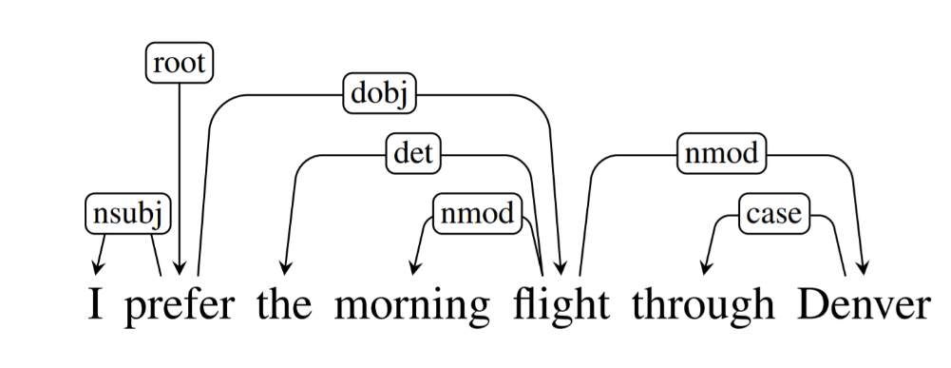
Natural language processing pipeline (cont.)
Dependency Parsing (DP):
Examines the dependencies between the phrases of a sentence to determine its grammatical structure.
Based on the assumption that there is a direct relationship between each linguistic unit in a sentence.
The relationships between each linguistic unit, or phrase, in the sentence are expressed by directed arcs.
Example: The diagram explains the sentence’s dependence structure.
Dependency tag | Description
root | The root of the tree
nsubj | nominal topic
dobj | direct object
det | determiner
nmod | nominal modifier
case | case-marking
Notes:
Dependency Parsing (DP) is the process of examining the dependencies between the phrases of a sentence to determine its grammatical structure. A sentence is divided into sections. The process assumes that there is a direct relationship between each linguistic unit in a sentence. These hyperlinks are called dependencies.
The example in the slide shows a diagram that explains the sentence’s dependence structure.
In a written dependency structure, the relationships between each linguistic unit, or phrase, in the sentence are expressed by directed arcs. In the example, the root of the tree “prefer” varies the pinnacle of the preceding sentence, as labelled in the diagram. Relations among the words are illustrated above the sentence with directed, labeled arcs from heads to dependents. A root node explicitly marks the root of the tree, the head of the entire structure.
A dependence tag indicates the relationship between linguistic units. For example, the word “flight” changes the meaning of the noun “Denver.” As a result, you might identify a dependence flight -> Denver, where flight is the pinnacle or head and Denver is the kid or dependent. It is represented by nmod, which stands for the nominal modifier.
The dependency tags that are used in the example are:
nominal subject (nsubj): nominal, which is the syntactic subject and the proto-agent of a clause.
direct object of a verb (dobj): noun phrase, which is the (accusative) object of the verb.
relation determiner (det): holds between a nominal head and its determiner.
nominal modifier (nmod): The nmod relation is used for nominal dependents of another noun or noun phrase and functionally corresponds to an attribute, or genitive complement.
Case: The case relation is used for any case-marking element, which is treated as a separate syntactic word (including prepositions, postpositions, and clitic case markers). Case-marking elements are treated as dependents of the noun that they attach to or introduce.
References:
Dependency Parsing
https://www.analyticsvidhya.com/blog/2021/12/dependency-parsing-in-natural-language-processing-with-examples/
Dependency Parsing
https://web.stanford.edu/~jurafsky/slp3/14.pdf
Universal Dependency Relations
https://universaldependencies.org/u/dep/
CoreNLP - Online tool to apply dependency parsing
https://corenlp.run/

Slide 37
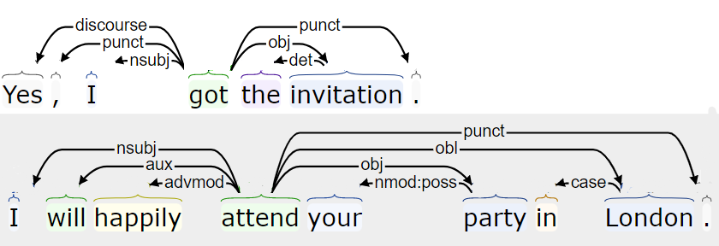
Natural language processing pipeline (cont.)
Dependency Parsing (DP) (cont.):
Apply dependency parsing (DP) to the example “Yes, I got the invitation. I will happily attend your party in London”
Dependency tag | Description
nsubj | nominal topic
punct | punctuation
discourse | discourse element
det | determiner
obj | the object of a verb
advmod | adverbial modifier
aux | auxiliary
nmod:poss | possessive nominal modifier
case | case-marking
Notes:
The slide shows the results of submitting the example “Yes, I got the invitation. I will happily attend your party in London”.
The dependency tags that are used in the example are:
nominal subject (nsubj): nominal, which is the syntactic subject and the proto-agent of a clause.
punctuation (punct): It is used for any piece of punctuation.
discourse: It is used for interjections and other discourse particles and elements, which are not clearly linked to the structure of the sentence, except in an expressive way.
obj: The object of a verb is the second most core argument of a verb after the subject. Typically, it is the noun phrase that denotes the entity acted upon or which undergoes a change of state or motion (the proto-patient).
advmod: An adverbial modifier of a word is a (non-clausal) adverb or adverbial phrase that serves to modify a predicate or a modifier word.
aux: An auxiliary of a clause is a function word that is associated with a verbal predicate that expresses categories such as tense, mood, aspect, voice or evidentiality. It is often a verb (which might have non-auxiliary uses) but many languages have nonverbal TAME markers, which are also treated as instances of aux.
nmod:poss It is used for a nominal modifier, which occurs before its head in the specifier position that is used for ‘s possessives.
Case: The case relation is used for any case-marking element, which is treated as a separate syntactic word (including prepositions, postpositions, and clitic case markers). Case-marking elements are treated as dependents of the noun that they attach to or introduce.
References:
CoreNLP - Online tool to apply dependency parsing
https://corenlp.run/
Universal Dependency Relations
https://universaldependencies.org/u/dep/

Slide 38
Natural language processing pipeline (cont.)
Part of speech (POS) tagging:
Tags words in correspondence with a particular part of speech (for example, nouns, verb, adjectives, pronouns) depending on the definition of the word and its context.
POS helps the computer to understand language and grammar and derive meaning from the input sentence.
The most famous data set is the Penn Treebank project.
Apply POS tags to the example:
First sentence:
“yes/UH” “,/,” ”I/PRP” “got/VBD” “the/DT” “invitation/NN” “,/,”
Second sentence:
“I/PRP” “will/MD” “happily/RB” “attend/VB” “your/PRP$” “party/NN”
“in/IN” “London/NNP”
Tag | Description
UH | Interjection
DT | Determiner
VBD | Verb, past tense
NN | Noun, singular or mass
MD | Modal
RB | Adverb
VB | Verb, base form
PRP | Personal pronoun
Notes:
POS tagging is the process of tagging each token with its grammatical representation, such as noun, verb, or adjective.
POS helps the computer to understand language and grammar and derive meaning from the input sentence.
In the example, the data set is English grammar, so according to the part of speech that are defined, the objective is to label each token by its proper grammar value, that is, the corresponding part of speech.
POS helps the computer to understand language and grammar and derive meaning from the input sentence. Many human-annotated data sets are publicly available. One of the most popular data sets is the one used by the Penn Treebank project.
References:
Part-of-speech tagging
https://en.wikipedia.org/wiki/Part-of-speech_tagging
Stanford Log-linear Part-Of-Speech Tagger
https://nlp.stanford.edu/software/tagger.shtml
Alphabetical list of part-of-speech tags used in the Penn Treebank Project:
https://www.ling.upenn.edu/courses/Fall_2003/ling001/penn_treebank_pos.html

Slide 39
Natural language processing pipeline (cont.)
Named Entity Recognition (NER):
Classifies named entities that are mentioned in the text into categories such as “People,” “Locations,” “Organizations,” and so on.
Example:
Text: “Google CEO Sundar Pichai resides in New York.”
Named entity recognition:
“Google” –> Organization
“Sundar Pichai” –> Person
“New York” –> Location
Apply named entity recognition (NER) to the example:
Second sentence: “I” “will” “happily” “attend” “your” “party” “in” “London”
“London” –> Location
Notes:
Named Entity Recognition (NER) is the process of detecting the named entity such as person name, movie name, organization name, or location.
References:
Preprocessing steps in Natural Language Processing (NLP)
https://www.educative.io/answers/preprocessing-steps-in-natural-language-processing-nlp
How to build an NLP pipeline
https://www.wikitechy.com/tutorial/nlp/how-to-build-an-nlp-pipeline

Slide 40
Natural language processing pipeline (cont.)
Chunking :
Collects individual pieces of information and groups them into larger units.
Helps to extract the important words from lengthy descriptions.
Example to identify nouns in a sentence:
Text: “I had burgers and pastries for breakfast.”
Chunk noun phrases: “burgers”, “pastries”, “breakfast”
Useful to group data within specific categories
Group fruits with certain nutritional properties: “fruits rich in proteins” and “fruits rich in vitamins”
Group cars with similar features: “cars with automatic gear” and “cars with manual gear”
Notes:
Chunking refers to the process of taking individual pieces of information and grouping them into larger units. Chunking can be used to identify part of speech and short phrases present in a sentence.
By grouping each data point into a larger whole, you can, for example, identify and group the part of speech noun, verb, adjective, adverb, preposition, conjunction, pronoun, and interjection and also short phrases formed by including any of these part of speech.
When you have loads of descriptions or modifications around a particular word or phrase of your interest, you use chunking to grab the required phrase or word alone, ignoring the rest around it. Hence, chunking paves a way to group the required phrases and exclude all the modifiers around them, which are not necessary for analysis.
Chunking is used in NLP applications, for example, to group fruits of a specific category, such as fruits rich in proteins, fruits rich in vitamins. Another example, chunking can also be used to group cars with similar features. For example, cars with automatic gear in one group and cars with manual gear into another group.
References:
Preprocessing steps in Natural Language Processing (NLP)
https://www.educative.io/answers/preprocessing-steps-in-natural-language-processing-nlp
How to build an NLP pipeline
https://www.wikitechy.com/tutorial/nlp/how-to-build-an-nlp-pipeline
What is Chunking in Natural Language processing?
https://www.analyticsvidhya.com/blog/2021/10/what-is-chunking-in-natural-language-processing/

Slide 41
Information retrieval

Slide 42
Information retrieval
Information retrieval is the process of accessing and retrieving the most appropriate information from text based on a particular query in natural language that is submitted by the user, with the help of context-based indexing or metadata.
An information retrieval system searches a collection of natural language documents with the goal of retrieving exactly the set of documents that matches a user’s question.
Information retrieval is the foundation of many search engines. .
Notes:
Information retrieval (IR) is the process of accessing and retrieving the most appropriate information from text based on a particular query in natural language that is submitted by the user, with the help of context-based indexing or metadata.
Google Search is the most popular example of an information retrieval application.
An information retrieval system searches a collection of natural language documents with the goal of retrieving exactly the set of documents that matches a user’s question. They have their origin in library systems.
These systems assist users in finding the information that they require but it does not attempt to deduce or generate answers. They provide information about the existence and location of documents that might contain the required information. The documents that satisfy the user’s requirement are called relevant documents. A perfect information retrieval system retrieves only relevant documents.
Reference:
Step by Step Guide to Master NLP – Information Retrieval
https://www.analyticsvidhya.com/blog/2021/06/part-20-step-by-step-guide-to-master-nlp-information-retrieval/

Slide 43
Information retrieval system steps
Indexing the collection of documents.
Transforming the query in the same way as the document content is represented.
Comparing the description of each document with that of the query.
Listing the results in order of relevancy.
Notes:
A user who needs information formulates a request in the form of a query in natural language. After that, the IR system returns output by retrieving the relevant documents, about the required information. The IR system accomplishes the goal by performing the following steps:
Indexing the collection of documents.
Transforming the query in the same way as the document content is represented.
Comparing the description of each document with that of the query.
Listing the results in order of relevancy.
References:
Step by Step Guide to Master NLP – Information Retrieval
https://www.analyticsvidhya.com/blog/2021/06/part-20-step-by-step-guide-to-master-nlp-information-retrieval/

Slide 44
Information retrieval systems main processes
Information retrieval systems consist of mainly two processes:
Indexing
The process of selecting terms to represent a text.
Tasks:
Matching
The process of finding a measure of similarity between two text representations
Tokenization of string
Removing frequent words
Stemming
The relevance of a document is computed based on the following parameters:
Term frequency (TF)
Inverse Document Frequency (IDF)
TF-IDF score
Notes:
Information retrieval systems consist of mainly two processes:
Indexing
Matching
Indexing is the process of selecting terms to represent a text.
Indexing involves:
Tokenization of string
Removing frequent words
Stemming
Two common Indexing Techniques:
Boolean Model
Vector space model
Matching is the process of finding a measure of similarity between two text representations.
The relevance of a document is computed based on the following parameters:
Reference:
Step by Step Guide to Master NLP – Information Retrieval
https://www.analyticsvidhya.com/blog/2021/06/part-20-step-by-step-guide-to-master-nlp-information-retrieval/

Slide 45
Term Frequency and Inverse Document Frequency
Term Frequency (TF): the number of times a term appears in a document.
TF(i, j) = (count of ith term in jth document)/(total terms in jth document)
Inverse Document Frequency (IDF): a measure of the general importance of the term.
ID (i) = (total no. of documents)/(no. of documents containing ith term)
TF-IDF score: is a combination of two weighting methods for information retrieval to determine how important a term is.
TF-IDF Score (i, j) = TF * IDF
Notes:
The relevance of a document is computed based on the following parameters:
TF. It stands for Term Frequency, which is the number of times a given term appears in that document.
TF (i, j) = (count of ith term in jth document)/(total terms in jth document)
IDF. It stands for Inverse Document Frequency, which is a measure of the general importance of the term.
IDF (i) = (total no. of documents)/(no. of documents containing ith term)
TF-IDF Score (i, j) = TF * IDF
Reference:
Step by Step Guide to Master NLP – Information Retrieval
https://www.analyticsvidhya.com/blog/2021/06/part-20-step-by-step-guide-to-master-nlp-information-retrieval/

Slide 46
Information extraction

Slide 47
Information extraction
Refers to the automatic extraction of structured information from unstructured or semi-structured text.
Examples of applications where information extraction is used:
Entities and relation identification
Sentiment analysis
Notes:
Information extraction refers to the automatic extraction of structured information from unstructured or semi-structured text.
For example, information extraction is used in the following applications:
Entities and relation identification
Sentiment analysis

Slide 48
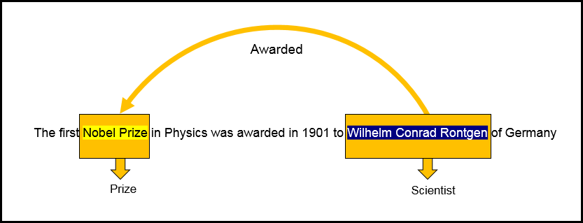
Information extraction (cont.)
Entities and relation identification
Notes:
As shown in this slide, “Nobel Prize” and “Wilhelm Conrad Rontgen” are identified as entities. The relationship is identified as awarded, which indicates the relationship between Wilhelm and the Nobel Prize.

Slide 49
Information extraction (cont.)
Sentiment analysis:
Detects user’s opinions in text.
Used in the field of chatbots, social media analysis, and others.
Examples:
“Their service is amazing” is a positive sentiment.
“The quality of food in this restaurant is terrible” is a negative sentiment.
“I am going to school” is a neutral sentiment.
Notes:
Sentiment analysis is the process of identifying emotions or opinions that are expressed in user input. It is used heavily in the fields of chatbots and social media analysis. It is also used in marketing because it captures a user’s opinion about a particular product or service so that an organization can take corrective action to keep the user satisfied.
Examples:
“Their service is amazing” is a positive sentiment.
“The quality of food in this restaurant is terrible” is a negative sentiment.
“I am going to school” is a neutral sentiment.

Slide 50
Watson NLP services

Slide 51
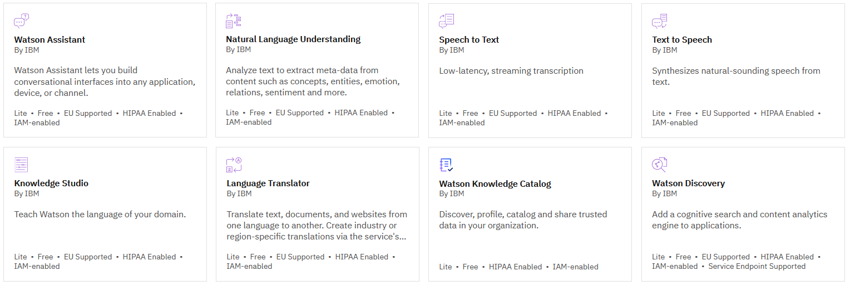
Watson NLP services
Notes:
Many Watson services have NLP at their core. The slide shows all the Watson NLP services on IBM Cloud.
The remainder of this presentation focuses on two Watson NLP services:
Natural Language Understanding
Watson Discovery
Other presentations in this course cover Watson Assistant and Knowledge Studio in detail.

Slide 52
Information extraction by using Watson services
Watson NLP services that extract information from unstructured text:
Watson Natural Language Understanding
Watson Discovery
Notes:
The Natural Language Understanding and Watson Discovery services are based on natural language processing (NLP) technology to extract information from unstructured text. These services can be used without training by the user because they include a built-in public model. They are pre-trained on a public training data set and ready to use immediately. However, to improve the accuracy of the service for a given domain, Natural Language Understanding and Discovery should also be trained.

Slide 53
Watson Natural Language Understanding

Slide 54
Watson Natural Language Understanding
NLU extracts meaning from unstructured data.
NLU processes input provided as text, HTML, or a public URL.
NLU analyzes the input text and provides an output that includes a set of text analytics features:
NLU can be extended with custom models for supported feature and language combinations.
Watson Knowledge Studio can be used to create a custom model for NLU to detect custom entities and relations that are unique to your domain.
(*) Tone analysis is done by using a pre-built classifications model.
Extraction
Entities
Classification or analysis
Sentiment
Linguistics
Semantic roles
Keywords
Concepts
Relations
Emotion
Categories
Syntax
Tone (*)
Notes:
Watson Natural Language Understanding (NLU) includes a set of text analytics features that you can use to extract meaning from unstructured data. NLU accepts user input and provides an output that includes entities and relationships that are found in the text. NLU can also perform sentiment analysis of the input text.
Input can be in the form of text, raw HTML, or a public URL. The service cleans HTML content before analysis by default so the results can ignore most advertisements and other unwanted content.
NLU can be extended with custom models for supported feature and language combinations.
You can create custom models by using Watson Knowledge Studio to detect custom entities and relations in NLU that are unique to your domain.
┌ Note ─────────────────
Tone analysis is done by using a pre-built classifications model. See next slide for more information.
└────────────────────
Reference:
Natural Language Understanding
https://cloud.ibm.com/apidocs/natural-language-understanding#introduction
Watson Natural Language Understanding – Details
https://www.ibm.com/uk-en/cloud/watson-natural-language-understanding/details
Overview - Customizing models
https://cloud.ibm.com/docs/natural-language-understanding?topic=natural-language-understanding-customizing

Slide 55
Watson Natural Language Understanding – Tone analytics
With the Natural Language Understanding service, you can analyze and detect tone by using a language-specific classifications model ID in your API request.
Tone analysis is done by using a pre-built classifications model, which provides an easy way to detect language tones in written text. It detects seven tones: sad, frustrated, satisfied, excited, polite, impolite, and sympathetic.
Example Request
Example Response
{
"language": "en",
"text": "This is example text in English.",
"features": {
"classifications": {
"model": "tone-classifications-en-v1"
}
}
}
{
"usage": {
"text_units": 1,
"text_characters": 60,
"features": 1
},
"language": "en",
"classifications": [
(cont.)
{
"confidence": 0.564849,
"class_name": "excited"
},
{
"confidence": 0.355816,
"class_name": "satisfied"
.........
Notes:
Tone analysis is done by using a pre-built classifications model, which provides an easy way to detect language tones in written text. It detects seven tones: sad, frustrated, satisfied, excited, polite, impolite, and sympathetic.
To detect tone, use the language-specific classifications model ID in your API request.
The language-specific tone model ID is formatted as tone-classifications-xx-v1, where xx is a two-character language code.
Tone analytics is currently available for English and French languages only, as indicated in the Language support topic at https://cloud.ibm.com/docs/natural-language-understanding?topic=natural-language-understanding-language-support.
References:
Understanding tone analytics
https://cloud.ibm.com/docs/natural-language-understanding?topic=natural-language-understanding-tone_analytics#understanding-tone-analytics
Language support
https://cloud.ibm.com/docs/natural-language-understanding?topic=natural-language-understanding-language-support

Slide 56
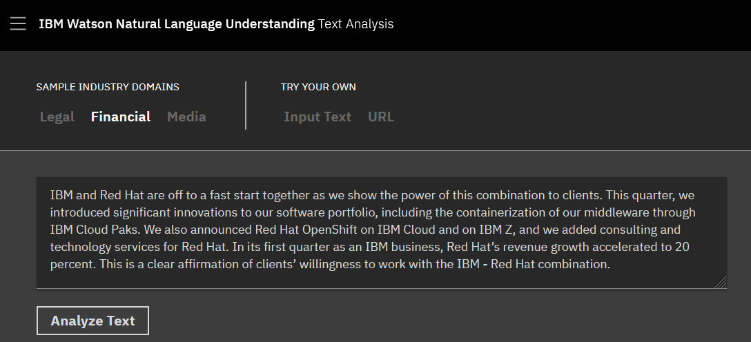
Natural Language Understanding demo
Notes:
The IBM Watson Natural Language Understanding Text Analysis online demo at
https://www.ibm.com/demos/live/natural-language-understanding/self-service/home demonstrates text analytics features that you can use to extract meaning from unstructured data by using the NLU service. In the demo, you can choose from a domain sample to apply the knowledge of unique entities and relations in a particular industry. Alternatively, you can analyze your own text by using the base model. The following slides show this demo with a financial domain sample.
Reference:
IBM Watson Natural Language Understanding Text Analysis
https://www.ibm.com/demos/live/natural-language-understanding/self-service/home

Slide 57
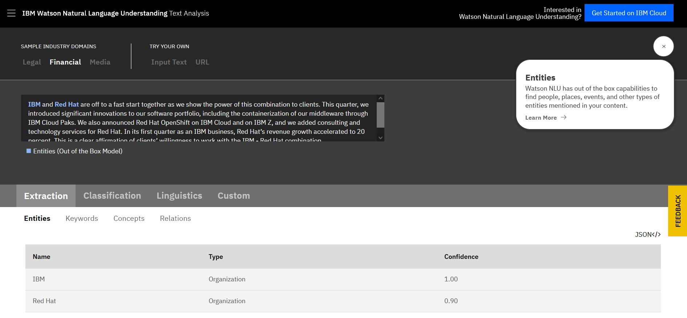
Natural Language Understanding demo – Entities extraction
Notes:
Watson Natural Language Understanding includes out of the box capabilities to find people, places, events, and other types of entities mentioned in your content.

Slide 58
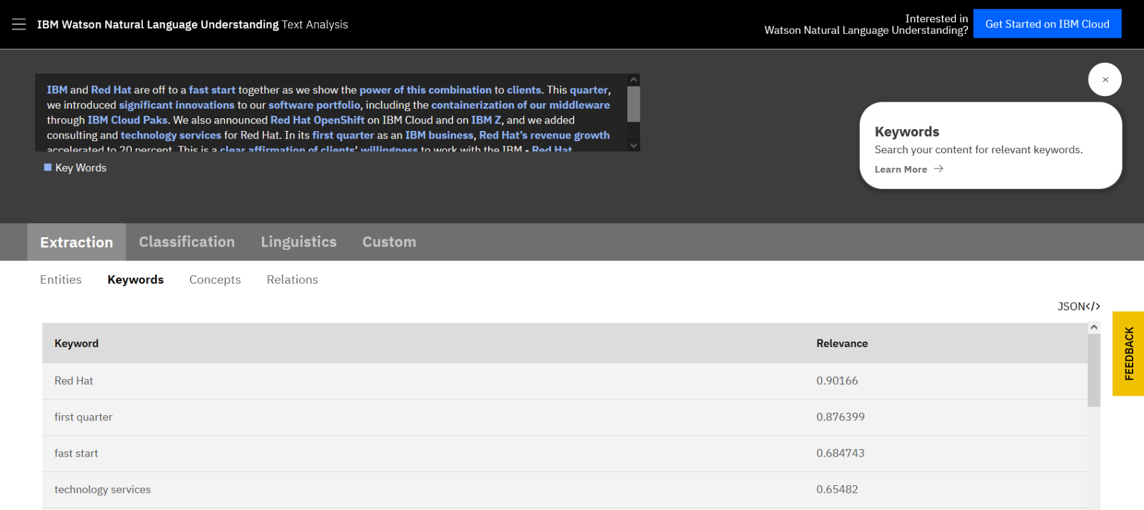
Natural Language Understanding demo – Keywords extraction
Notes:
With Watson Natural Language Understanding, you can extract keywords and search for the relevant ones.

Slide 59
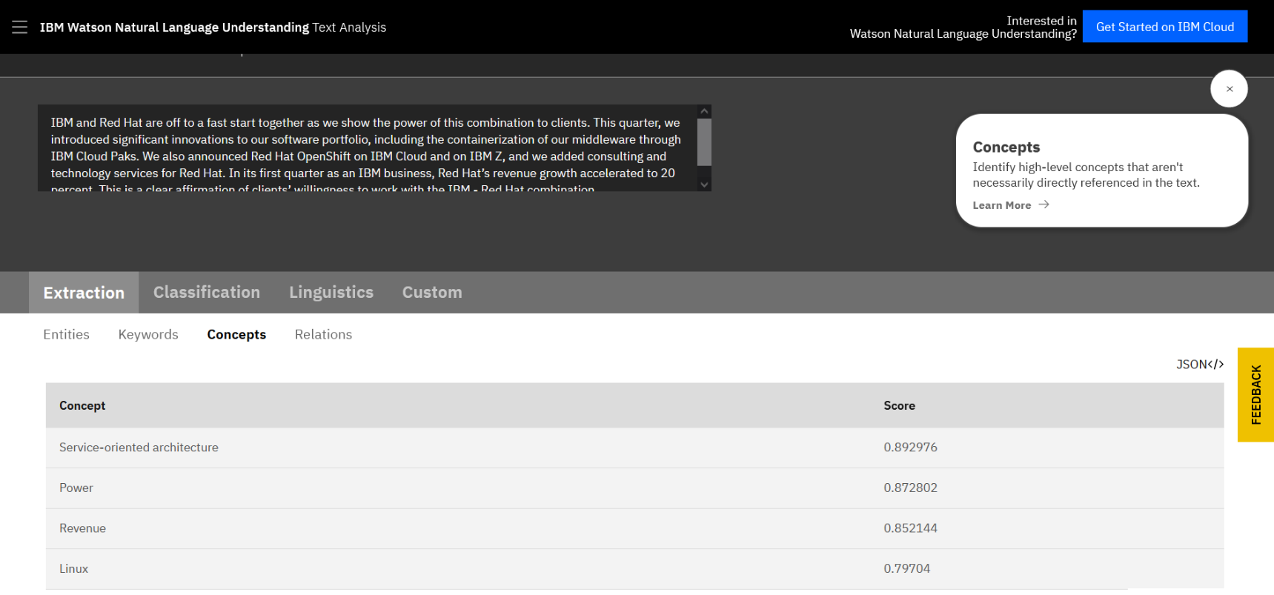
Natural Language Understanding demo – Concepts extraction
Notes:
Natural Language Understanding can identify high-level concepts that are not necessarily directly referenced in the text.

Slide 60
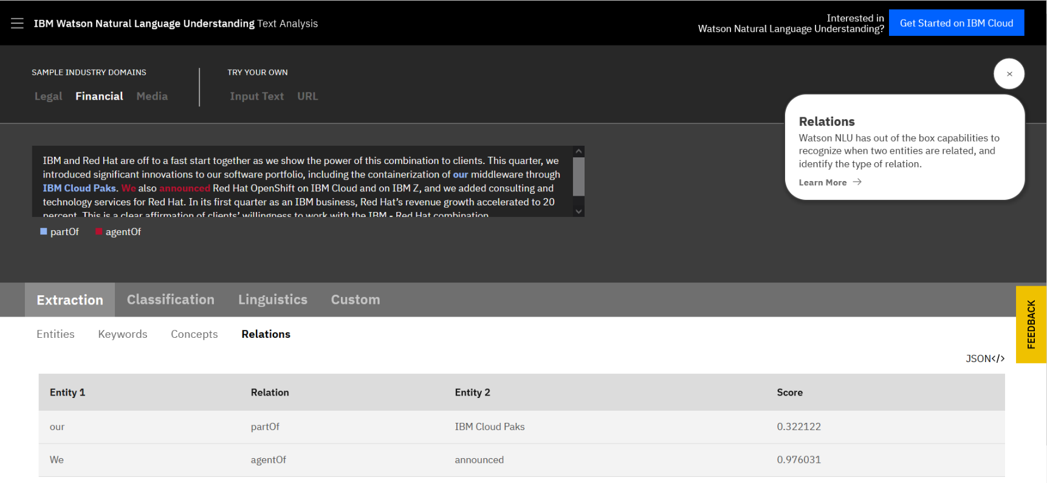
Natural Language Understanding demo – Relations extraction
Notes:
Natural Language Understanding can recognize when two entities are related and identify the type of relation.

Slide 61
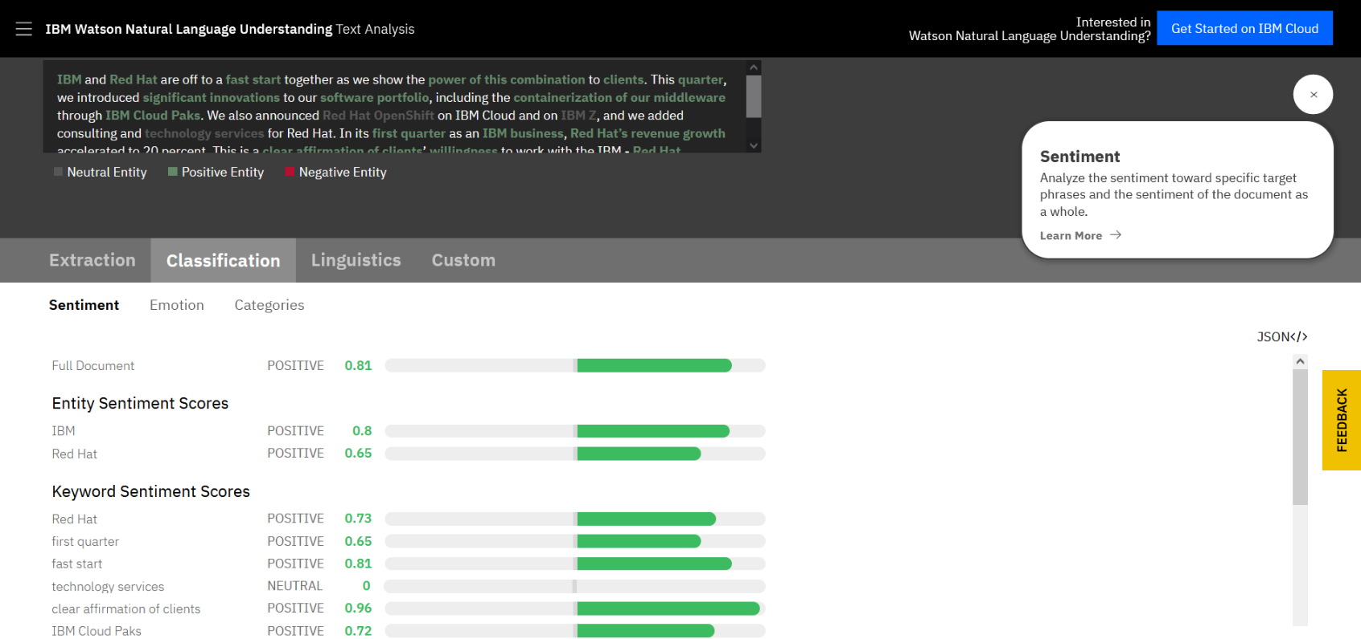
Natural Language Understanding demo – Sentiment analysis
Notes:
Natural Language Understanding can analyze the sentiment toward specific target phrases and the sentiment of the document as a whole.

Slide 62
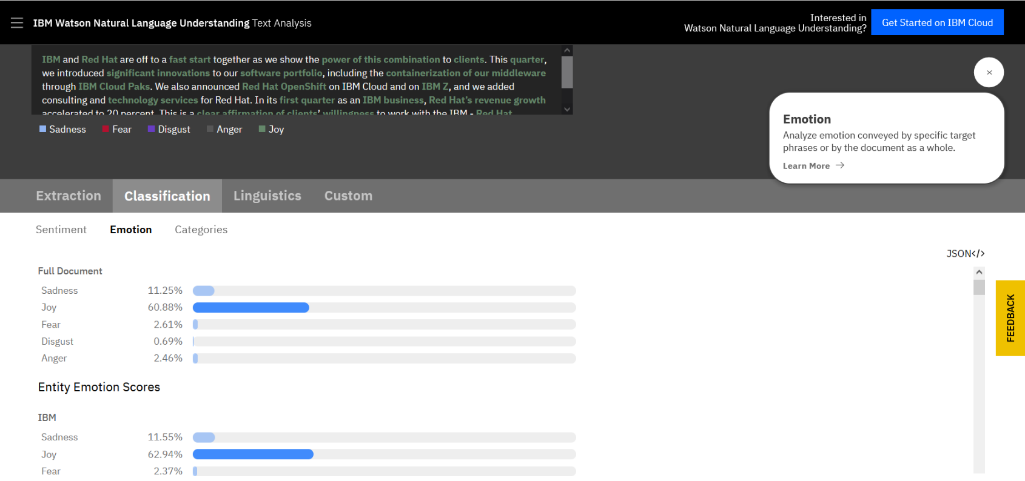
Natural Language Understanding demo – Emotion analysis
Notes:
Natural Language Understanding can analyze emotion that is conveyed by specific target phrases or by the document as a whole.

Slide 63
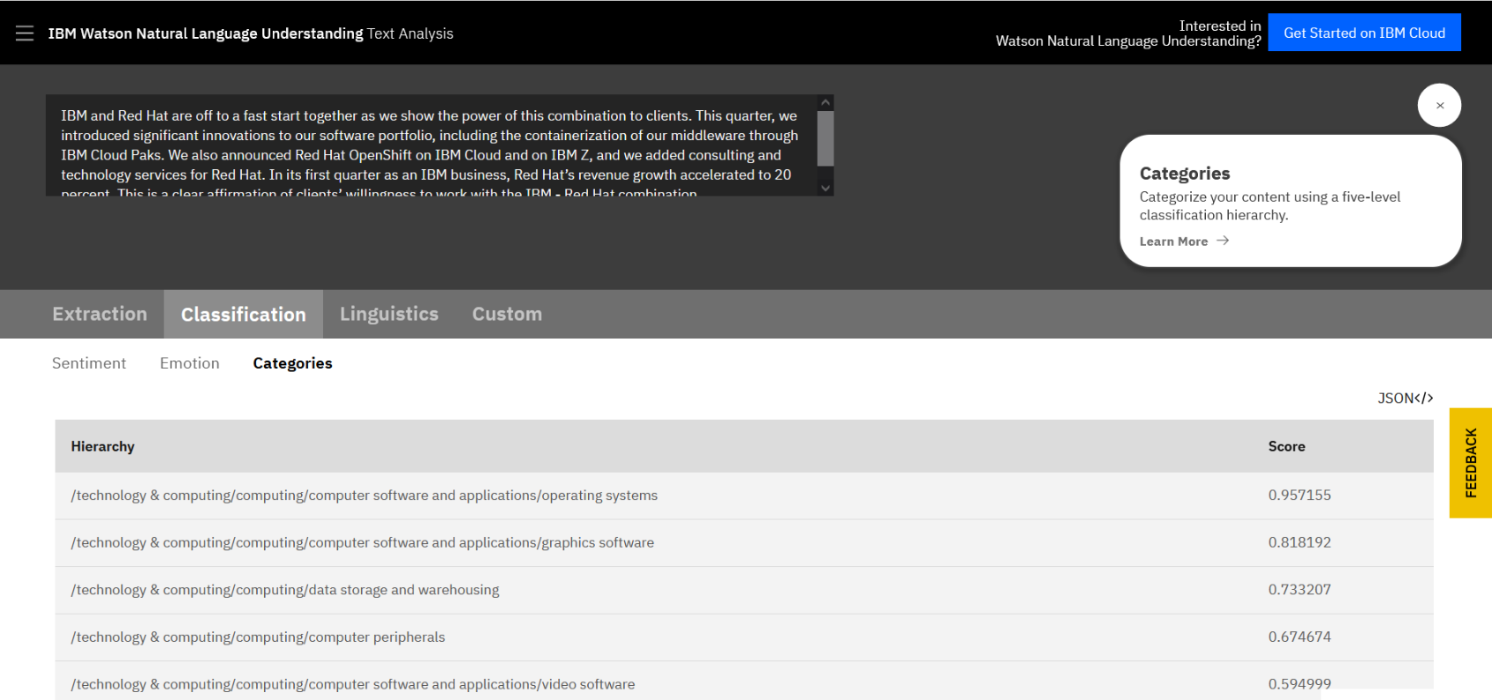
Natural Language Understanding demo – Categories classification
Notes:
Natural Language Understanding can categorize your content by using a five-level classification hierarchy.

Slide 64
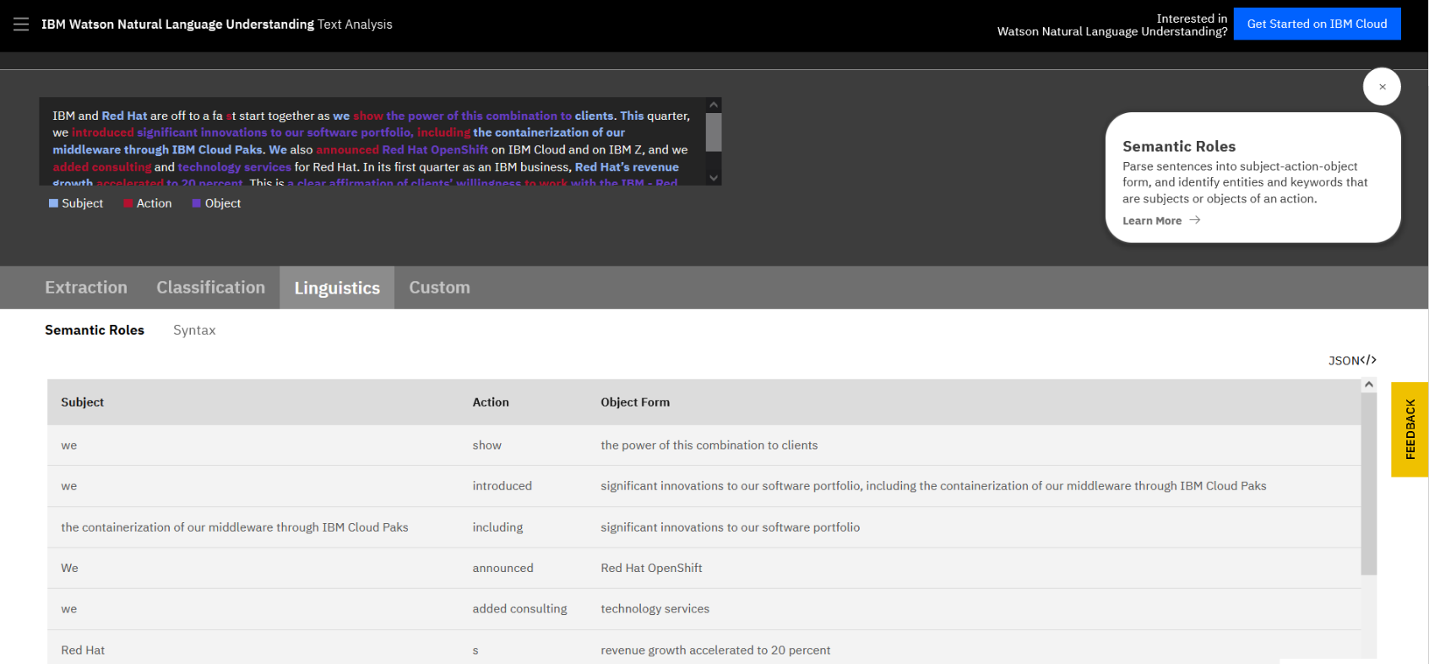
Natural Language Understanding demo – Semantic roles
Notes:
Natural Language Understanding can parse sentences into subject-action-object form and identify entities and keywords that are subjects or objects of an action.

Slide 65
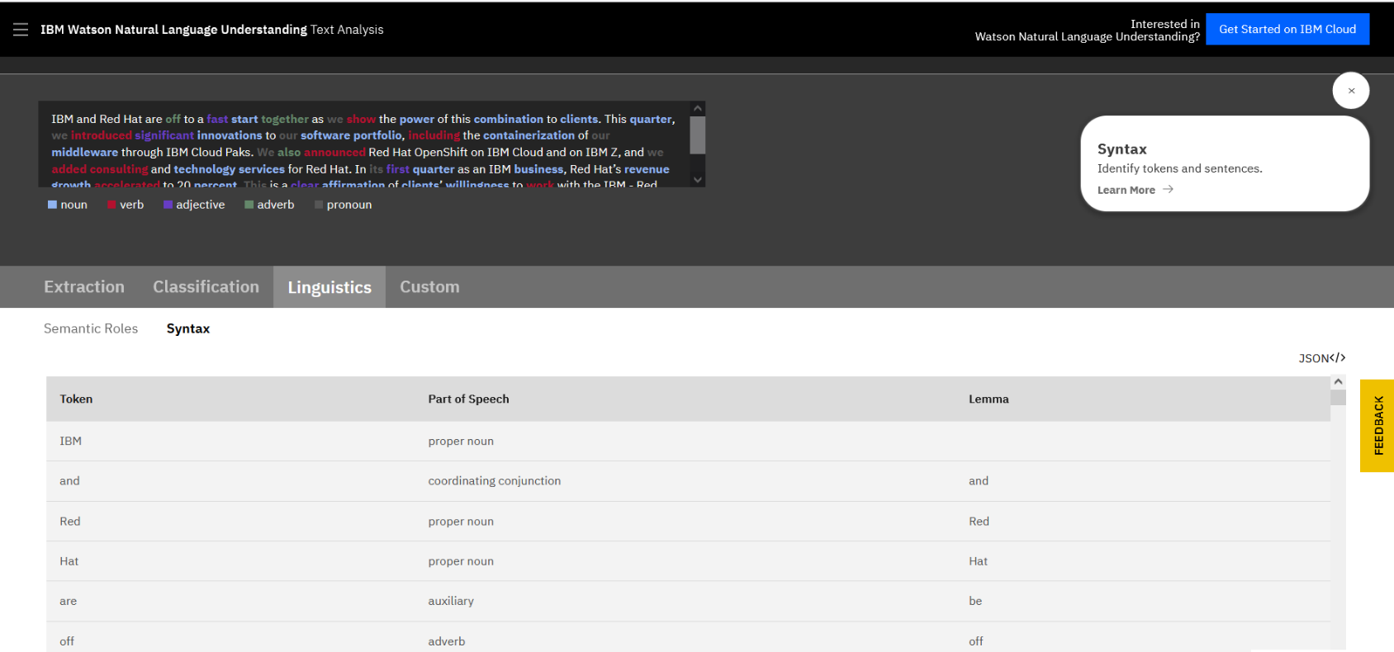
Natural Language Understanding demo – Syntax
Notes:
Natural Language Understanding can identify tokens and sentences.

Slide 66
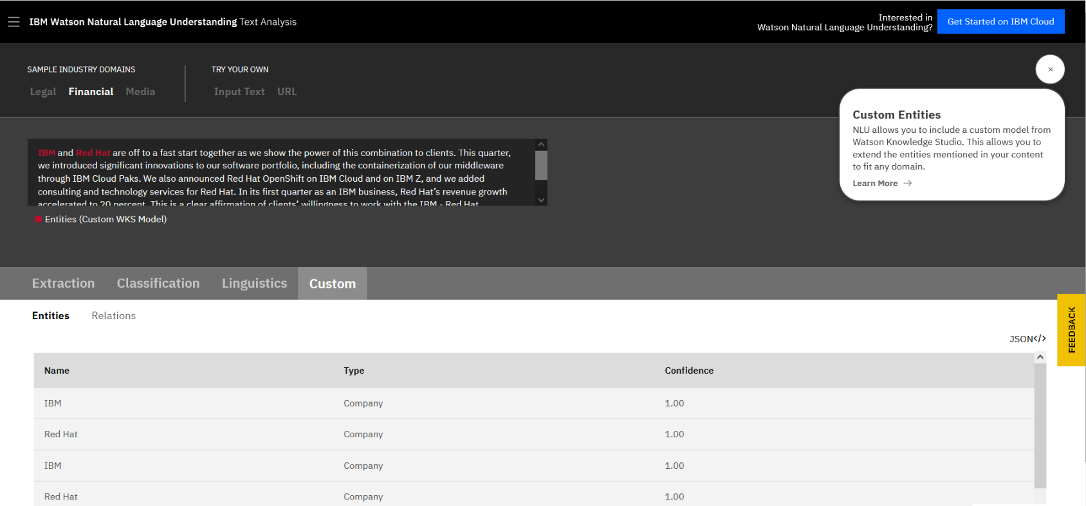
Natural Language Understanding demo – Custom entities
Notes:
Natural Language Understanding allows you to include a custom model from Watson Knowledge Studio so that you can extend the entities that are mentioned in your content to fit any domain.

Slide 67
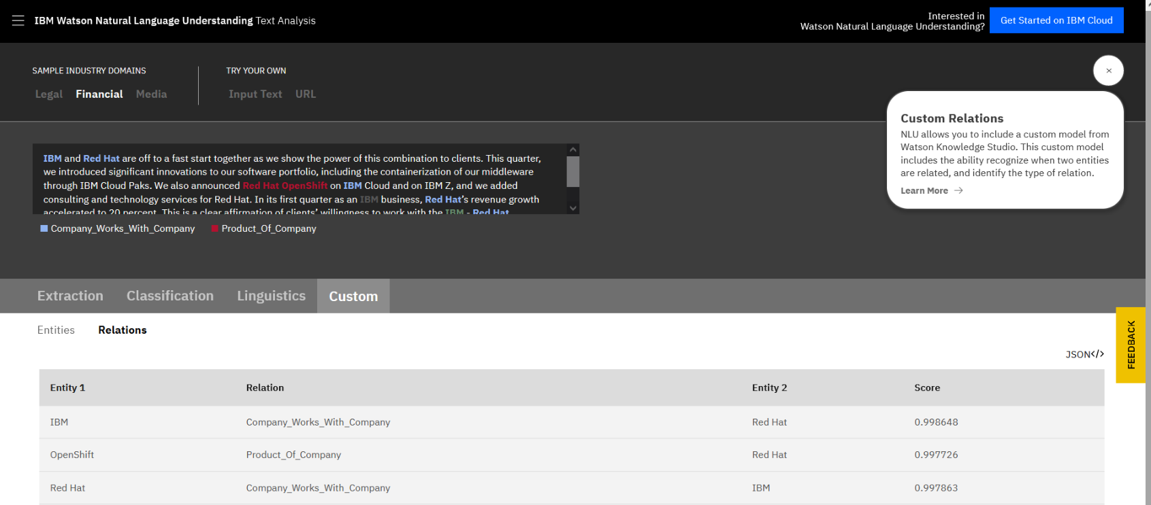
Natural Language Understanding demo – Custom relations
Notes:
Natural Language Understanding allows you to include a custom model from Watson Knowledge Studio. This custom model includes the ability recognize when two entities are related and identify the type of relation.

Slide 68
Watson Discovery

Slide 69
Watson Discovery
Adds cognitive search and content analytics to applications to identify patterns, trends, and insights.
Unlocks actionable insights in unstructured data.
Unifies structured and unstructured data.
Uses simple query language to eliminate the need for manual filtering of results.
Parses documents and enables the user to search through the documents by using a natural language query.
Can be trained.
Includes the Discovery API and Discovery tooling.
Example application: Find answers to FAQs
Notes:
Watson Discovery
With Watson Discovery, you can add a cognitive search and a content analytics engine to applications to identify patterns, trends, and actionable insights that drive better decision-making. You can rapidly build cognitive, cloud-based exploration applications that unlock actionable insights that are hidden in unstructured data.
You can securely unify structured and unstructured data with pre-enriched content and use a simplified query language to eliminate the need for manual filtering of results.
With Discovery, you can prepare your unstructured data, create a query to pinpoint the information you need, and then integrate those insights into your new application or existing solution.
The Watson Discovery services include:
Discovery API. The Discovery service supports various SDKs to simplify the development of applications. The SDKs are available for many popular programming languages and platforms, including Curl, Java, NodeJS, Python, Go, .NET, Ruby, Swift, and Unity.
Discovery tooling. The Discovery service includes a complete set of online tools, the Discovery tooling, to help you quickly set up an instance of the service and populate it with data. The Discovery service tooling was designed to save time by eliminating the need to use APIs to configure and populate your service.
With Discovery, you can build applications that extract the correct answers to FAQs by enriching and searching data collections.
References:
Watson Discovery on Cloud Pak for Data as a Service
https://dataplatform.cloud.ibm.com/docs/content/svc-welcome/watsondisc.html?context=cpdaas&audience=wdp
Discovery API documentation
https://cloud.ibm.com/apidocs/discovery-data?code=unity#introduction

Slide 70
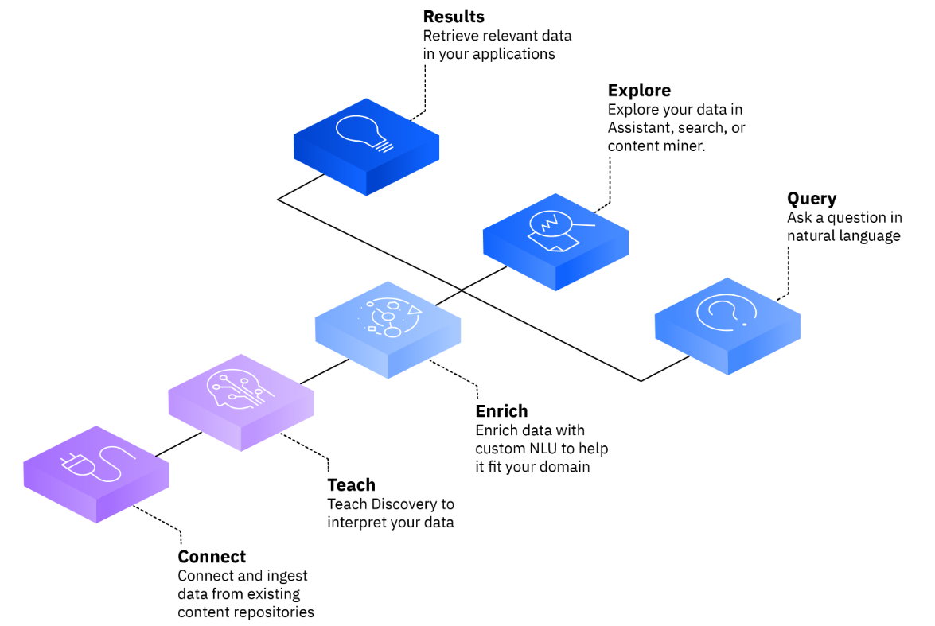
Watson Discovery flow
Discovery provides an end-to-end solution that includes:
Connect your data to Discovery.
Teach Discovery to understand the language and concepts that are unique to your business and industry.
Enrich your data with NLU technologies to identify key information and patterns.
Build search solutions that find answers to queries.
Explore your data to uncover patterns and insights.
Leverage search results in automated workflows.
Notes:
IBM Watson Discovery is an AI-powered search engine that helps you to extract answers from complex business documents.
Use Discovery to visually train AI for deep understanding of your content, including tables and images to help you find business value that is hidden in your enterprise data. Use natural language or structured queries to find relevant answers, surface insights, and build AI-enhanced business processes anywhere.
Start by connecting your data to Discovery. Next, teach Discovery to understand the language and concepts that are unique to your business and industry. Enrich your data with award-winning Natural Language Understanding (NLU) technologies so you can identify key information and patterns. Finally, build search solutions that find answers to queries, explore your data to uncover patterns and insights, and leverage search results in automated workflows.
Supported file types: CSV, DOC, DOCX, GIF, HTML, JPG, JSON, PDF, PNG, PPT, PPTX, TIFF, TXT, XLS, XLSX
References:
About Watson Discovery
https://cloud.ibm.com/docs/discovery-data?topic=discovery-data-about
Supported file types
https://cloud.ibm.com/docs/discovery-data?topic=discovery-data-collections#supportedfiletypes

Slide 71
Watson Assistant experiences

Slide 72
About Watson Assistant experiences
Use IBM Watson Assistant to build your own branded live chatbot, which is known as an assistant, into any device, application, or channel.
Watson Assistant provides two experiences to build assistants:
New Watson Assistant experience
Classic Watson Assistant experience
Notes:
Use IBM Watson Assistant to build your own branded live chatbot, which is known as an assistant, into any device, application, or channel.
Your chatbot, which is also known as an assistant, connects to the customer engagement resources you already use to deliver an engaging, unified problem-solving experience to your customers.
Watson Assistant provides two experiences to build assistants:
New Watson Assistant experience
Classic Watson Assistant experience

Slide 73
New Watson Assistant experience
In October 2021, the new Watson Assistant became available.
Watson Assistant was revamped to make it easier and faster to build, publish, and improve a chatbot.
The new Watson Assistant has a build experience that is tailored to the people who directly interact with customers daily, such as customer service representatives and customer-care experts.
The new experience is focused on using actions to build customer conversations,
Steps within the action represent back-and-forth interactions between your assistant and your customer.
The new Watson Assistant automatically handles things that might go wrong during a conversation, such as topic changes, vague requests, misunderstandings, and asking for a human agent.
The new Watson Assistant navigation is more intuitive and follows the order of the steps that are recommended to get your assistant live.
Notes:
The new experience refers to the Watson Assistant build experience that was announced on October 7, 2021.
Watson Assistant was revamped to make it easier and faster to build, publish, and improve a chatbot.
The new Watson Assistant has a build experience that is tailored to the people who directly interact with customers daily, such as customer service representatives and customer-care.
The new experience is focused on using actions to build customer conversations,
Steps within the action represent back-and-forth interactions between your assistant and your customer.
The new Watson Assistant automatically handles things that might go wrong during a conversation, such as topic changes, vague requests, misunderstandings, and asking for a human agent.
The new Watson Assistant navigation is more intuitive and follows the order of the steps that are recommended to get your assistant live.
References:
The new Watson Assistant announcement – October 7 2021
https://cloud.ibm.com/docs/assistant?topic=assistant-release-notes#assistant-oct072021
Welcome to the new Watson Assistant (documentation)
https://cloud.ibm.com/docs/watson-assistant
FAQs about the new IBM Watson Assistant experience
https://cloud.ibm.com/docs/watson-assistant?topic=watson-assistant-watson-assistant-faqs#faqs-new-experience
Comparing actions and dialog
https://cloud.ibm.com/docs/watson-assistant?topic=watson-assistant-comparing-actions-dialog
Migrating to the new experience
https://cloud.ibm.com/docs/watson-assistant?topic=watson-assistant-migrate-overview
Switching between new and classic experiences
https://cloud.ibm.com/docs/watson-assistant?topic=watson-assistant-switch-experience

Slide 74
Classic Watson Assistant experience
The classic experience refers to the Watson Assistant build experience that was available before the new experience was announced in October 2021.
The classic experience is built around the following concepts:
Skills
Intents
Entities
Dialog
Customers that built their assistants by using the classic experience can migrate to the new experience or remain in the classic experience.
A dialog-based conversation is the best choice when you want greater control over the logic of the flow.
The dialog flow uses an if-then-else style structure that might be familiar to developers, but not to content designers or customer-care experts.
Notes:
The classic experience refers to the Watson Assistant build experience that was available before the new experience was announced in October 2021.
No matter what the specific purpose of your chatbot is, some core fundamentals are always involved:
Skills
Intents
Entities
Dialog
Each of these functions and their application to the Watson Assistant service are explained in detail in the Classic Watson Assistant topic
The dialog component is optional because some chatbots are developed to answer user questions in a question-and-answer manner that is similar to the approach that is used to answer frequently asked questions (FAQs).
These chatbots need to understand only what the user is asking and reply with the proper answer. Chatbots that are meant to answer FAQs do not have to engage in a conversation with the user and therefore they do not need a dialog component.
Customers that built their assistants by using the classic experience can migrate to the new experience or remain in the classic experience.
A dialog-based conversation is the best choice when you want greater control over the logic of the flow.
The dialog flow uses an if-then-else style structure that might be familiar to developers, but not to content designers or customer-care experts.
References:
About Watson Assistant
https://cloud.ibm.com/docs/assistant?topic=assistant-index
Migrating to the new experience
https://cloud.ibm.com/docs/watson-assistant?topic=watson-assistant-migrate-overview
Comparing actions and dialog
https://cloud.ibm.com/docs/watson-assistant?topic=watson-assistant-comparing-actions-dialog
Switching between new and classic experiences
https://cloud.ibm.com/docs/watson-assistant?topic=watson-assistant-switch-experience
FAQ
https://cloud.ibm.com/docs/assistant?topic=assistant-faqs

Slide 75
New Watson Assistant
Notes:
New Watson Assistant documentation https://cloud.ibm.com/docs/watson-assistant
Watson Assistant blog https://www.ibm.com/blogs/watson/

Slide 76
The new Watson Assistant
The new Watson Assistant experience is focused on using actions to build customer conversations.
New navigation provides a workflow for building, previewing, publishing, and analyzing your assistant.
Each assistant has a home page with a task list to help you get started.
Build conversations with actions, which represent the tasks that you want your assistant to help your customers with.
Each action contains a series of steps that represent individual exchanges with a customer.
When you publish, you can review and debug your work in a draft environment before you go live to your customers.
Use a new suite of analytics to improve your assistant.
Review which actions are being completed to see what your customers want help with, determine whether your assistant understands and addresses customer needs, and decide how can you make your assistant better.
Switching the experience
You can easily switch back and forth between the new experience and the classic experience.
Notes:
The new Watson Assistant experience is focused on using actions to build customer conversations. It is designed to make it simple enough for anyone to build a virtual assistant. Building, testing, publishing, and analyzing your assistant can all now be done in one simple and intuitive interface.
New navigation provides a workflow for building, previewing, publishing, and analyzing your assistant.
Each assistant has a home page with a task list to help you get started.
Build conversations with actions, which represent the tasks that you want your assistant to help your customers with.
Each action contains a series of steps that represent individual exchanges with a customer.
When you publish, you can review and debug your work in a draft environment before you go live to your customers.
Use a new suite of analytics to improve your assistant.
Review which actions are being completed to see what your customers want help with, determine whether your assistant understands and addresses customer needs, and decide how can you make your assistant better.
Switching the experience
You can easily switch back and forth between the new experience and the classic experience. However, the new experience provides a simplified user interface, an improved deployment process, and access to the latest features.
References:
Welcome to the new Watson Assistant
https://cloud.ibm.com/docs/watson-assistant?topic=watson-assistant-welcome-new-assistant
Watson Assistant documentation
https://cloud.ibm.com/docs/watson-assistant
FAQs about the new IBM Watson Assistant experience.
https://cloud.ibm.com/docs/watson-assistant?topic=watson-assistant-watson-assistant-faqs#faqs-new-experience
Getting started with Watson Assistant
https://cloud.ibm.com/docs/watson-assistant?topic=watson-assistant-getting-started
Migrating to the new experience.
https://cloud.ibm.com/docs/watson-assistant?topic=watson-assistant-migrate-overview
Switching between new and classic experiences
https://cloud.ibm.com/docs/watson-assistant?topic=watson-assistant-switch-experience

Slide 77
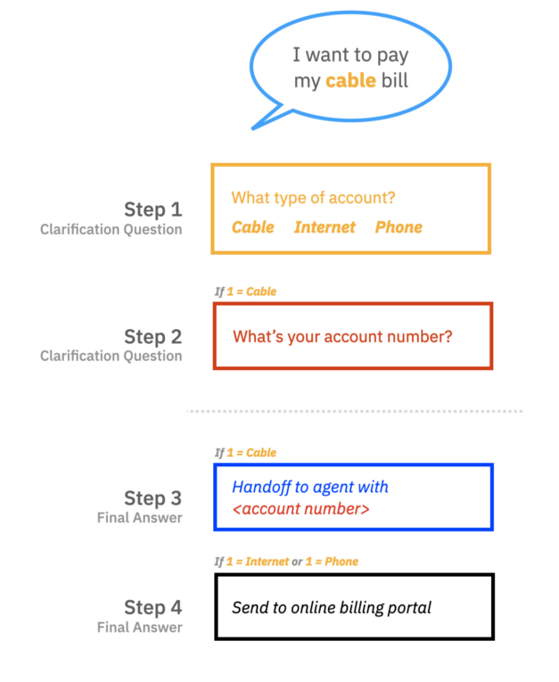
Building your assistant with Action and Step
Like a human personal assistant, the assistant you build helps your customers perform tasks and answer questions. To accomplish this, you define actions for the assistant.
What is an Action?
An action is a problem or a task that your customer wants to resolve. For example, paying a bill, getting an invoice, getting the balance in a bank account, withdrawing money, saying hello, or asking about the weather might all be an action in your assistant.
What is a Step?
A step is a back-and-forth interaction between your assistant and your customer.
Steps represent the clarification questions, final answers, or human agent handoff points in the action.
Notes:
Like a human personal assistant, the assistant you build helps your customers perform tasks and answer questions. To accomplish this, you define actions and steps for the assistant.
An action is a problem or a task that your customer wants to resolve. For example, paying a bill, getting an invoice, getting the balance in a bank account, withdrawing money, saying hello, or asking about the weather might all be an action in your assistant.
An action represents a discrete outcome that you want your assistant to be able to accomplish in response to a user's request. An action comprises the interaction between a customer and the assistant about a particular question or request. This interaction begins with the user input that starts the action (for example, ”I want to withdraw money”). It might then include additional exchanges as the assistant gathers more information, and it ends when the assistant carries out the request or answers the customer's question.
A step is a back-and-forth interaction between the assistant and the customer.
Steps represent the clarification questions, final answers, or human agent handoff points in the action.
Everything else that the step needs to function like the flow logic, response options, or storage of the user’s response is contained within the step.
In the example that is shown in the slide, the assistant asks clarification questions before it hands the conversation over to an agent (with the account number as context) for a cable bill. For internet or phone bills the assistant guides the user to the online billing portal.
An action consists of one or more steps. The steps in an action define the conversation turns that follow the initial customer input that triggered the action. In a simple case, a step might consist of a direct answer to a question from the customer; for example, if the customer asks “What are your business hours?”, a one-step action might reply with “We are open Monday through Friday from 9 AM to 5 PM”.
More commonly, an action requires multiple steps to fully understand the customer's request. For the example, If the customer says “I want to pay my cable bill” the assistant needs more information such as “what is your account number?” Each of these follow-up questions represents a step in the action.
┌ Information ───────────
For step-by-step instructions on the Billing Assistant scenario that is described in this presentation, see the tutorial “Getting Started with the New Watson Assistant: The Build Guide Part I” at https://www.ibm.com/blogs/watson/2021/12/getting-started-with-the-new-watson-assistant-part-i-the-build-guide/
└────────────────────
References:
Getting Started with the New Watson Assistant: The Build Guide Part I
https://www.ibm.com/blogs/watson/2021/12/getting-started-with-the-new-watson-assistant-part-i-the-build-guide/
Getting Started with the new Watson Assistant: Plan It
https://www.ibm.com/blogs/watson/2021/11/getting-started-with-the-new-watson-assistant-plan-it/
Overview: Editing actions
https://cloud.ibm.com/docs/watson-assistant?topic=watson-assistant-build-actions-overview

Slide 78
Actions benefits
Using actions is the best choice when you want to approach the assistant with a focus on content.
The process of creating a conversational flow is easier. People who have expertise with customer care can write the words that your assistant says.
Actions provide better visibility into the customer's interaction and satisfaction with the assistant.
The conversation designer doesn't have to manage data collected during the conversation. By default, your assistant collects and stores information for the duration of the current action.
Many people can work at the same time in separate, self-contained actions. The order of actions within a conversation doesn't matter.
Notes:
Using actions is the best choice when you want to approach the assistant with a focus on content. Actions offers the following benefits:
The process of creating a conversational flow is easier. People who have expertise with customer care can write the words that your assistant says. With a simplified process anyone can build a conversation. You don't need knowledge about machine learning or programming.
Actions provide better visibility into the customer's interaction and satisfaction with the assistant. Because each task is discrete and has a clear beginning and ending, you can track user progress through a task and identify snags.
The conversation designer doesn't have to manage data collected during the conversation. By default, your assistant collects and stores information for the duration of the current action. You don't need to take extra steps to delete saved data or reset the conversation. But if you want, you can store certain types of information, such as the customer's name, for the duration of a conversation.
Many people can work at the same time in separate, self-contained actions. The order of actions within a conversation doesn't matter. Only the order of steps within an action matters. And the action author can use drag and drop to reorganize the steps in the action for optimal flow.
Reference:
Comparing actions and dialog
https://cloud.ibm.com/docs/watson-assistant?topic=watson-assistant-comparing-actions-dialog

Slide 79
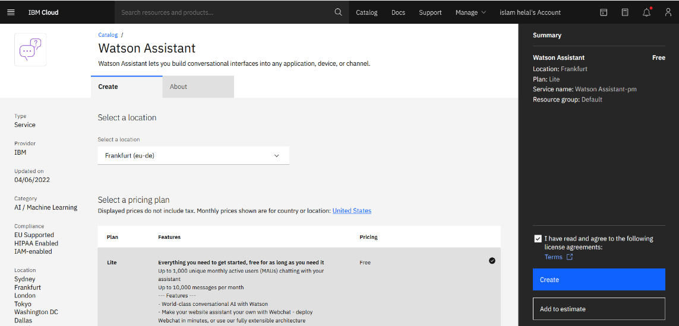
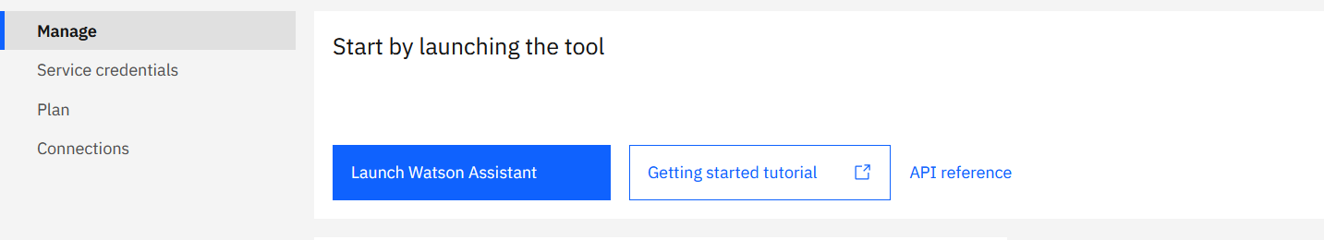
Creating your first assistant
Create a Watson Assistant service instance.
Launch the Watson assistant tool.
1
2
Notes:
To create your first assistant, complete these steps:
Create a Watson Assistant service. You can use an existing Watson Assistant service if you already have one.
After you create the service instance, the dashboard for the instance opens. Click Launch Watson Assistant to open the tool and create your assistant.

Slide 80
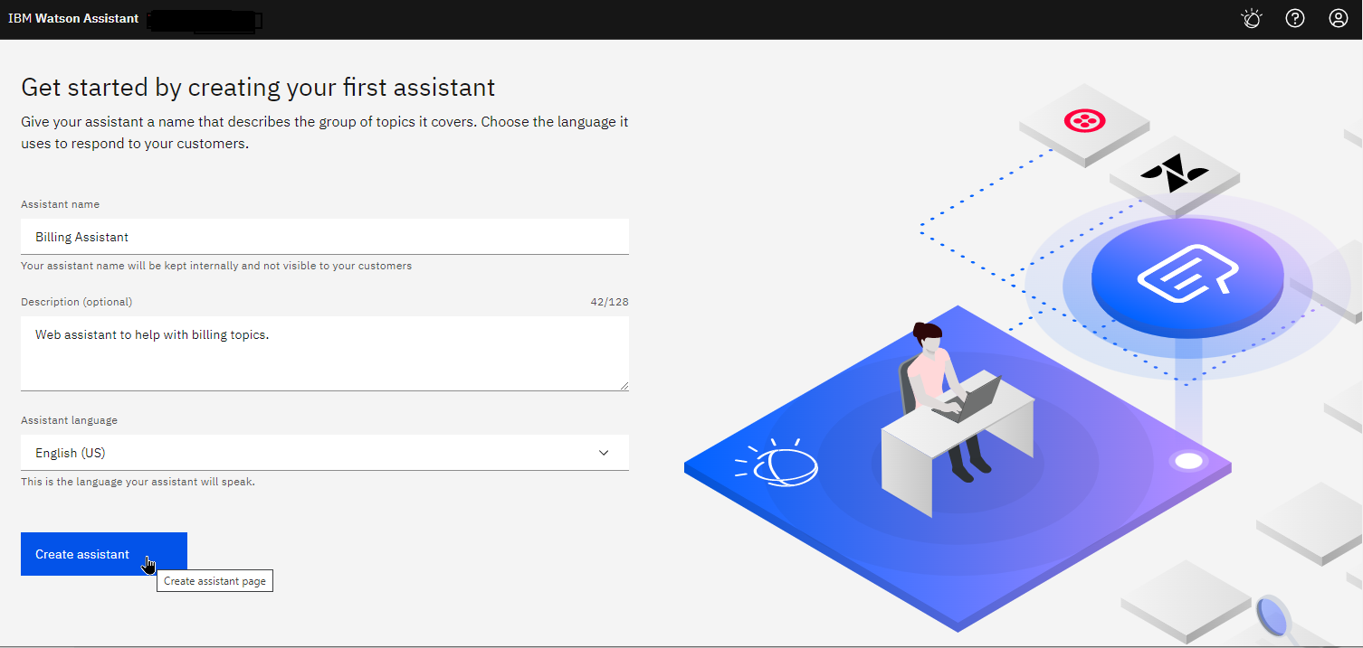
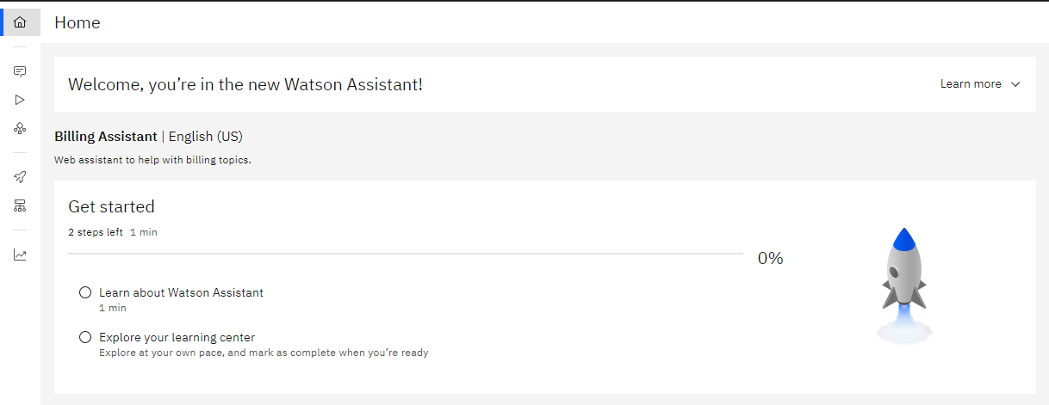
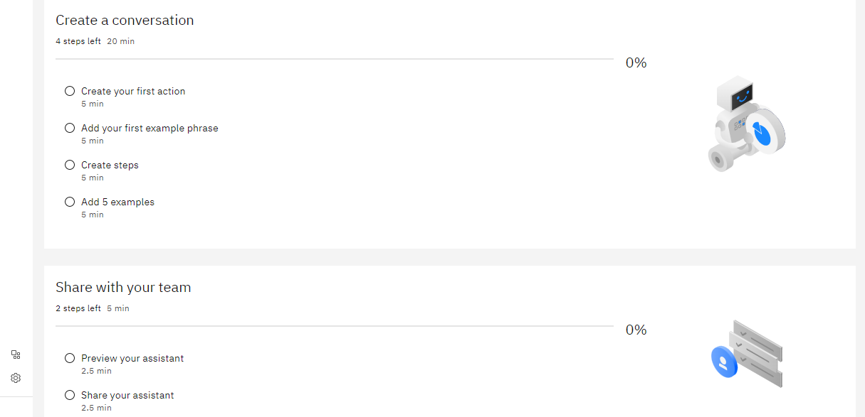
Creating your first assistant (cont.)
Create your assistant. Example, Billing Assistant.
The assistant Home page opens.
3
4
Notes:
Give your assistant a name that describes the group of topics it covers. In this example, Billing Assistant. Choose the language it uses to respond to your customers and click Create assistant.
The Home page of your assistant is displayed.

Slide 81
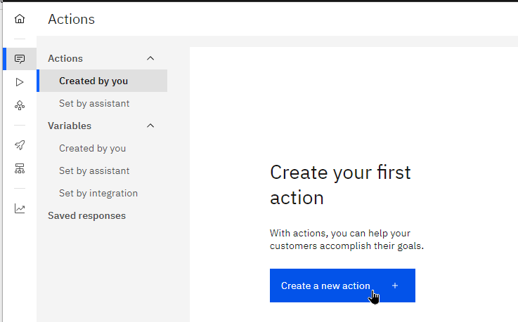
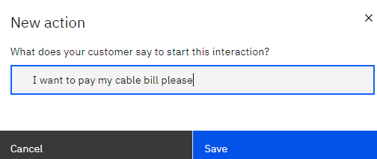
Creating your first Action
Actions represent the topics that your assistant can handle, for example “pay bill”.
Enter an example of the customer interaction. You “train” your assistant’s topic-recognition AI by giving it example sentences.
When you create a new action, you are prompted to provide the first example like “I want to pay my cable bill please”.
Notes:
Actions represent the tasks or questions that your assistant can help customers with. Each action has a beginning and an end, making up a conversation between the assistant and a customer.
When you create a new action, Watson Assistant prompts you for an example of the customer’s input that starts the action.
From the navigation panel on the left click Actions to create a new action and then click Create a new action.
In the “New action” window, at the prompt "What does your customer say to start this interaction?", type an example of your customers interactions for this action. In this example, “I want to pay my cable bill please”.

Slide 82

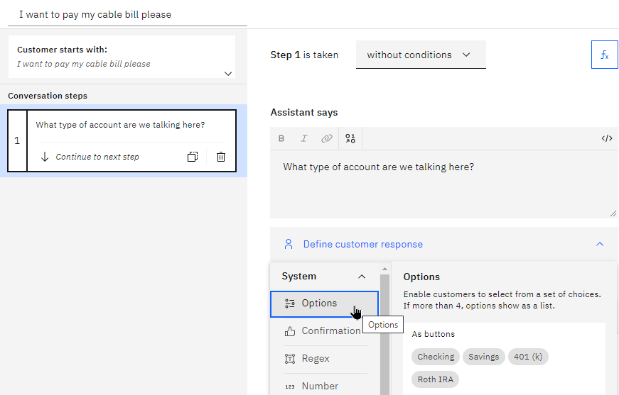
Creating your first Step – Step 1
Add a step to ask a clarification question, for example, the type of account, which has a bill that needs to be paid. Step 1 is created by default.
Add the clarification question in the “Assistant says” text box.
Select the type of customer response that the assistant should wait for. In this case, Options is the best choice.
Notes:
Now it’s time to create the first step in the bill pay interaction.
Step 1 is already created for you.
Select the step to edit it and add the clarification question in the “assistant says” text box. In this example, “What type of account are we talking here?”.
Then, select the type of customer response that the assistant should wait for. In this case, Options is the best choice.

Slide 83
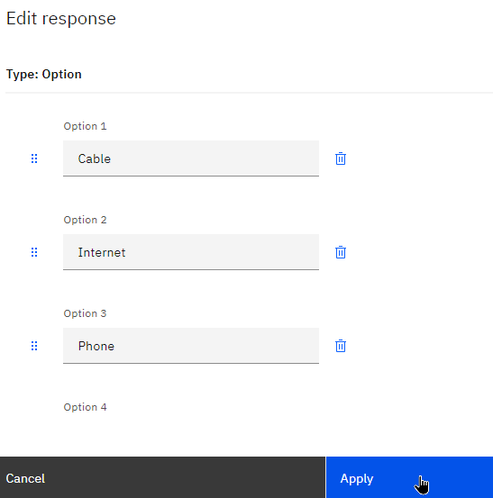
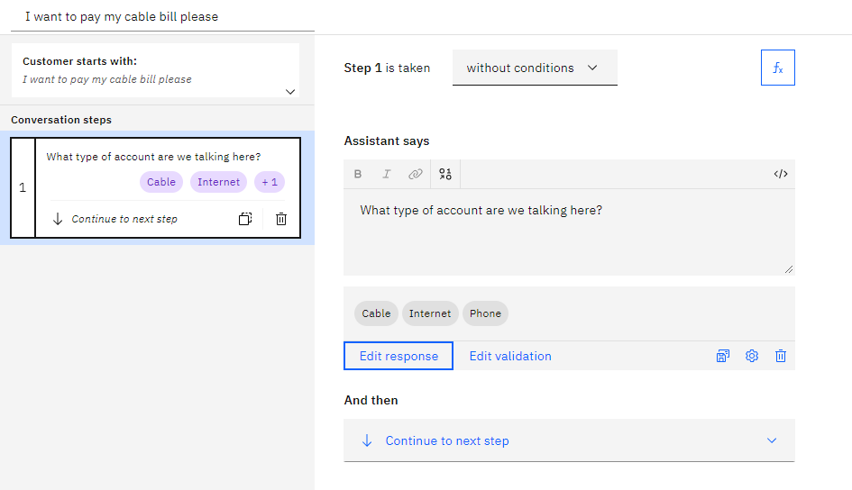
Creating your first Step – Step 1 (cont.)
Add the three options for Cable, Internet, and Phone, and apply your changes.
Notes:
Add the three options for Cable, Internet, and Phone, and apply your changes.
Finally, the first step looks as shown in the figure on the right.

Slide 84
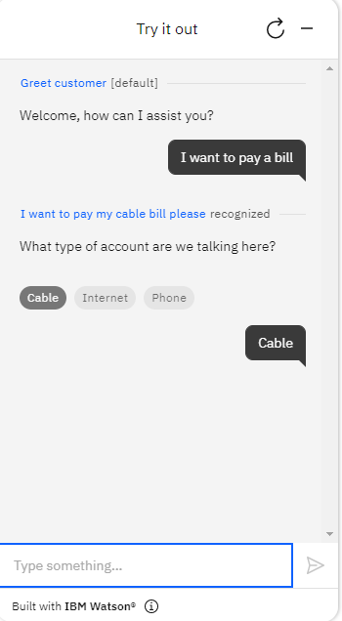

Trying out your action
Click Try it to preview your action to make sure it works.
Notes:
Now preview your action to make sure it works.
Click Try it in the lower right of your screen. Try out a few interactions and see that it properly recognizes what you ask it. Try typing something other than what you used as your training sentence.

Slide 85
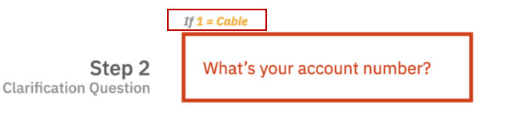

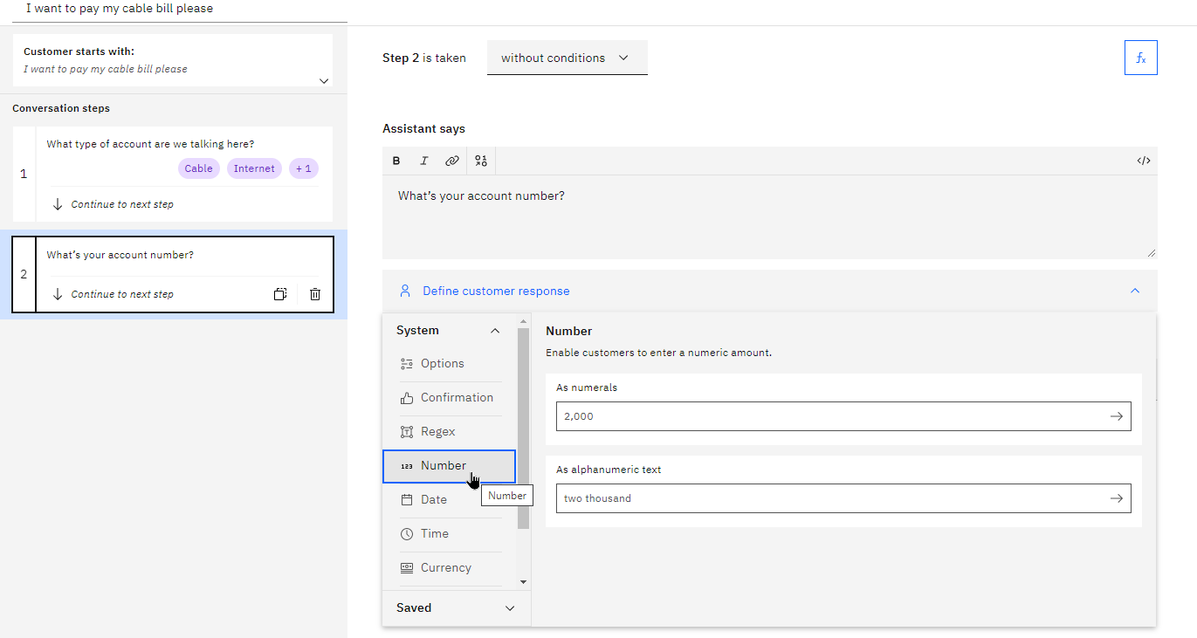
Adding more steps to the conversation – Step 2
Add a step to ask a clarification question, for example, the account number.
Click New step
Add the clarification question What’s your account number?
Select Number for the type of customer response.
Notes:
The steps in an action define the conversation turns that follow the initial customer input that triggered the action. In a simplest case, a step might consist of a direct answer to a question from the customer; for example, if the customer asks. What are your business hours?, a one-step action might reply with “We are open Monday through Friday from 9 AM to 5 PM”.
Usually, an action requires multiple steps to fully understand the customer's request.
For example, if the customer wants to pay a bill, the assistant needs to know the account number.
If the customer asks, “I want to withdraw money”, the assistant needs more information:
Which account should the money come from?
What is the amount to withdraw?
Each of these follow-up questions represents a step in the action.
In this example:
Add Step 2 below Step 1 by clicking New step.
In the “Assistant says” field, type the clarification question to ask for the account number, “What’s your account number?”.
Select Number from the response drop-down list as the type of customer response.

Slide 86
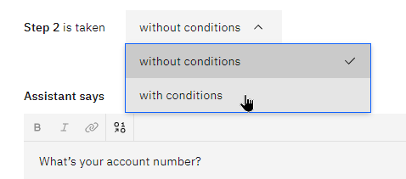
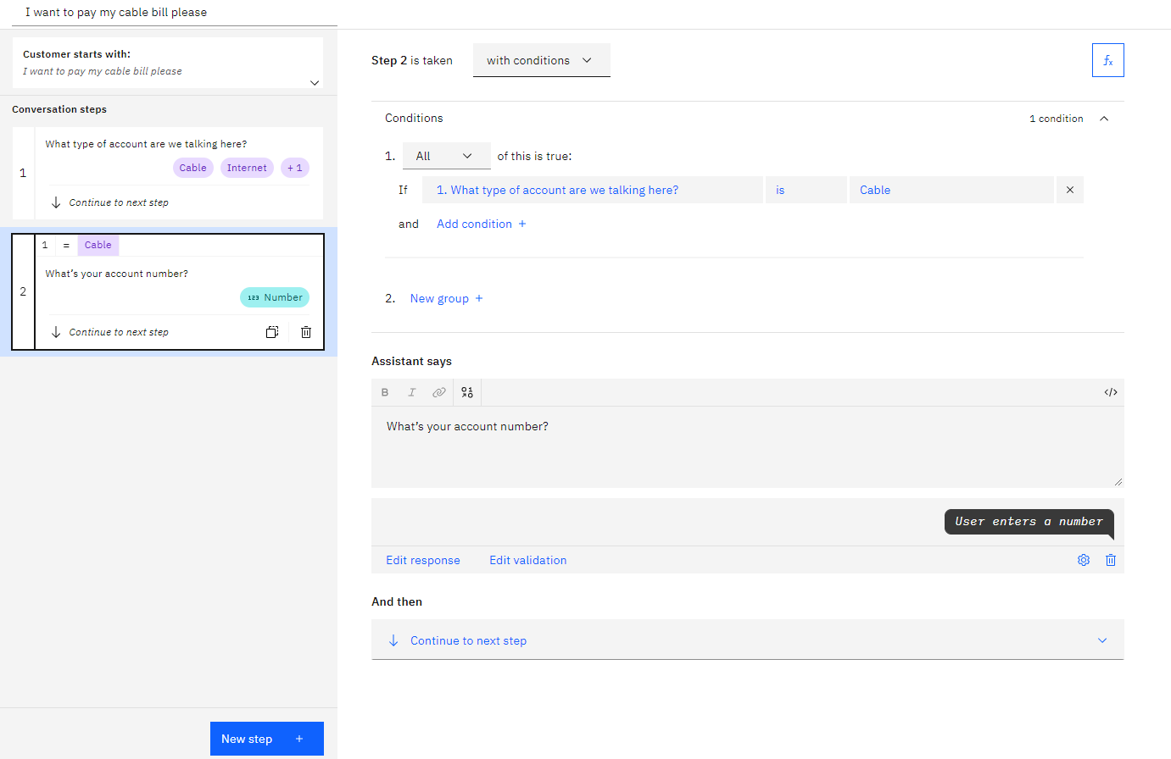
Adding logic (conditions) to the flow – Step 2
In this example, the customer should be prompted for an account number only for cable bills.
Add a condition to Step 2.
Step 2 is taken with conditions.
Condition: answer to step 1 = Cable but not Internet or Phone.
Notes:
Next, you need to add some flow logic to the flow. In this example, given the way that this flow works, an account number should be gathered only for cable bills. To handle this scenario, you need to add a condition to your step. To do that, change the step to be taken with conditions instead of without.
Conditions are basically requirements, which must be met for the step to be triggered. In this case, you want to condition on the answer to step 1 being “Cable” but not Internet or Phone. To set it up, make sure that you have the condition set to step 1 = Cable.

Slide 87

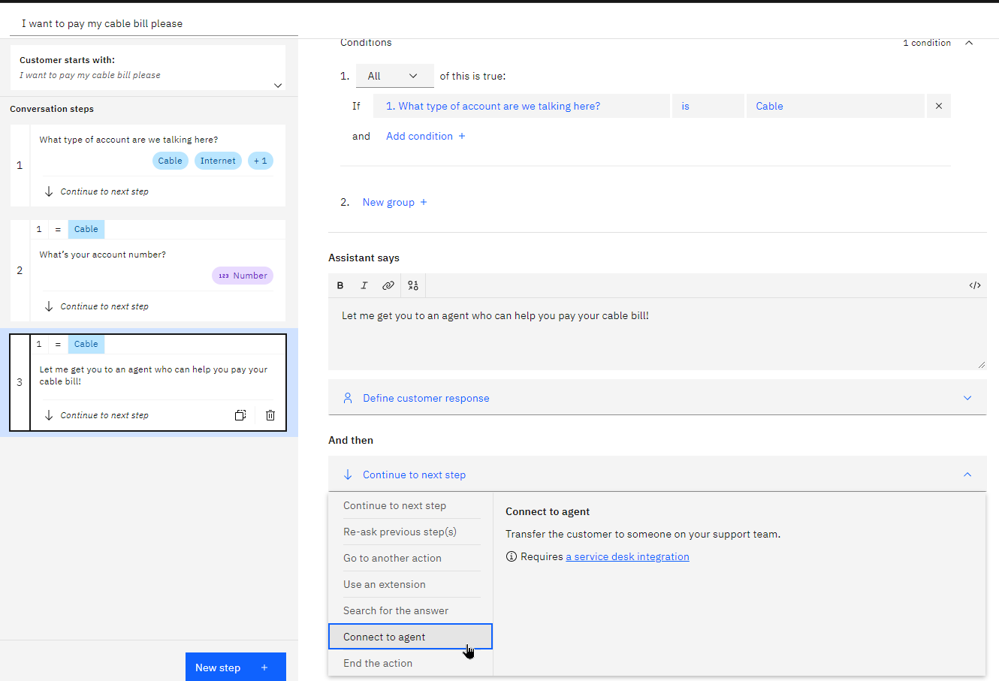
Adding an agent handoff step – Step 3
Add step 3 under step 2.
Enter text related to getting the user to an agent to pay their bill. “Let me get you to an agent who can help you pay your cable bill!.”
Condition step 3 on “step 1 = Cable”.
For this step, you don’t need to gather any information from the user, so you can leave the Define customer response section empty.
Change And then to Connect to agent.
Notes:
Now, you need to add the last steps to provide the outcome to the user.
Add step 3 under step 2.
Enter some text related to getting the user to an agent to pay their bill. For example, “Let me get you to an agent who can help you pay your cable bill!.”
Condition step 3 on “step 1 = Cable” as you did in step 2.
For this step, you don’t need to gather any information from the user, so you can leave the “Define customer response” section empty.
Now, set up the assistant to route this conversation to a human agent. Change the And then setting to Connect to agent (connect to a human agent), which also ends the action when it hands off.

Slide 88
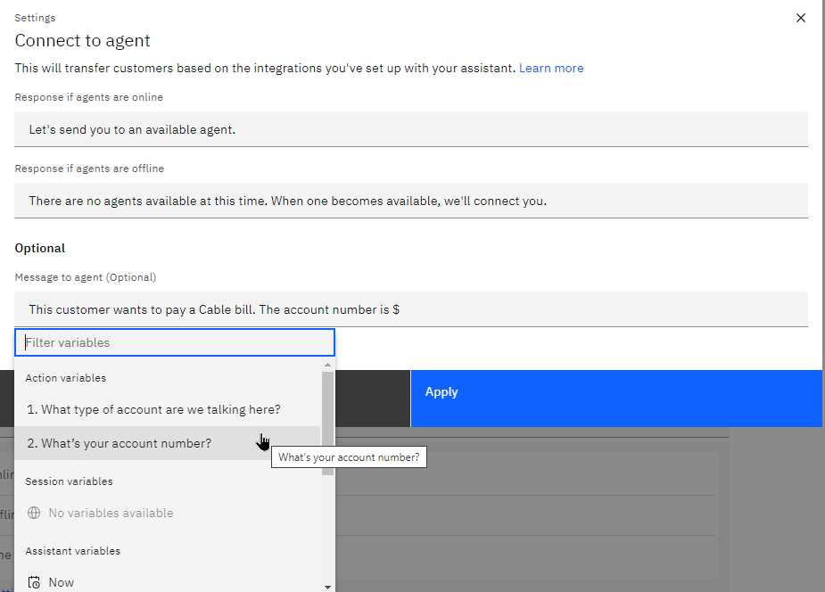
Inserting the context to pass to the human agent – Step 3
Insert the context that you gathered for the human agent to review.
The customer wants to pay their Cable bill.
The account number. Select step 2 (the account number) as the field that you want to insert
Apply your changes.
Hint: To insert the content of the variables that you collected into text, start with the “$” sign and a quick select box appears as shown in the figure.
Notes:
In the prompt that comes up, you insert the context that you gathered for the human agent to review. Namely, the fact that the customer wants to pay their Cable bill and the account number.
┌ Hint ─────────────────
To insert the content of the variables that you collected into text, start with the “$” sign and a quick select box appears as shown in the figure.
└────────────────────
Insert the context that you gathered for the human agent to review.
The customer wants to pay their Cable bill.
The account number. Select step 2 (the account number) as the field that you want to insert
Apply your changes.

Slide 89
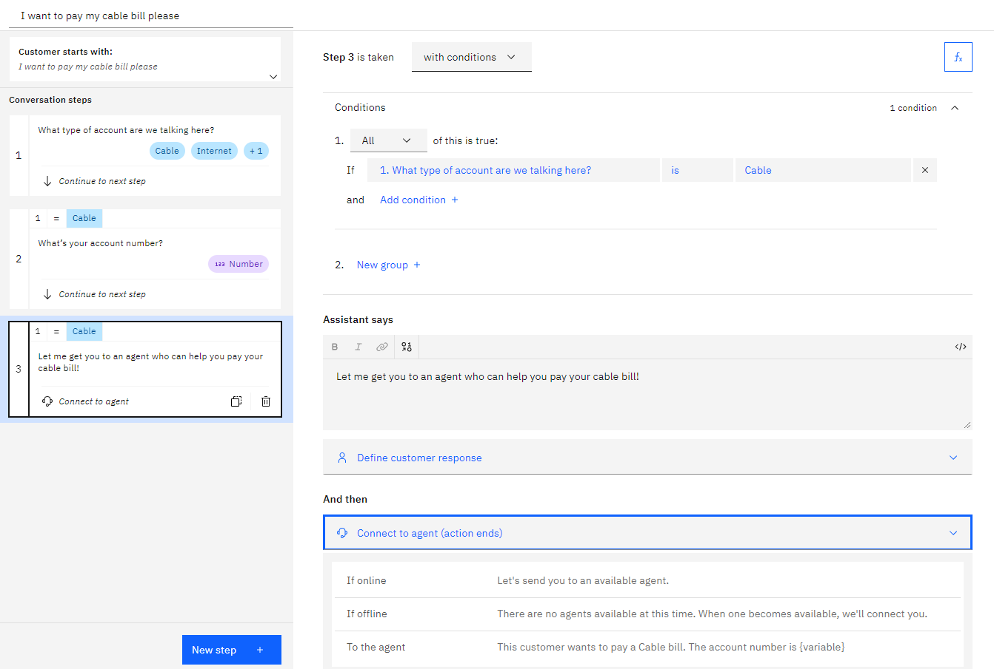
Handoff to agent step wrap-up – Step 3
Notes:
The slide shows the completed step 3, which derives the customer to a human agent and passes the context that is collected from the user.

Slide 90
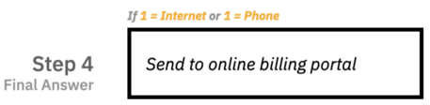
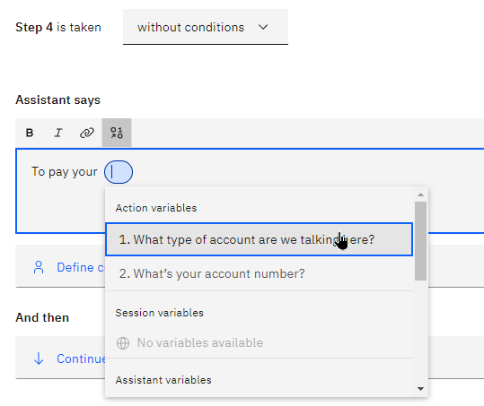

Creating a final response – Step 4 (1 of 5)
Add a final step to wrap up the conversation. Step 4 tells the customer, To pay your <type of bill> bill, you can head to our online portal <link to portal>
To insert a variable like the type of bill to be paid, click the Insert a variable button that is located over the text box.
Notes:
Add a final step to wrap up the conversation. Step 4 tells the customer, “To pay your <type of bill> bill, you can head to our online portal <link to portal>”
To insert a variable like the type of bill to be paid, click the Insert a variable button that is located over the text box.

Slide 91
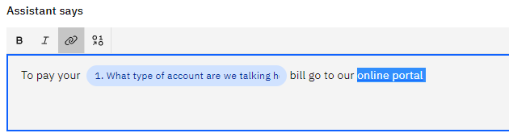
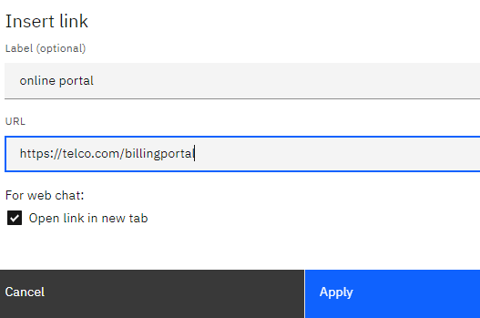
Creating a final response – Step 4 (2 of 5)
To add a link to the text, highlight the text that you want to use and then click the Link button.
Enter the URL in the “Insert link” window.
Notes:
To add a link to the text, highlight the text that you want to use and then click the Link button.
Enter the URL in the “Insert link” window.
The settings for the link look like the figure.

Slide 92
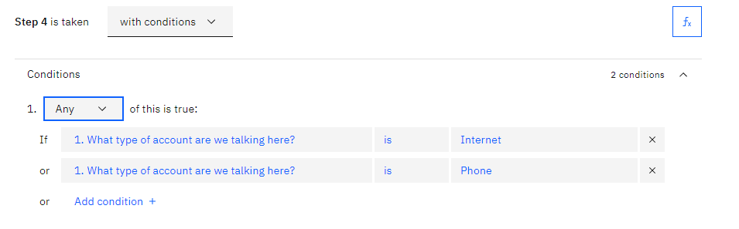
Creating a final response – Step 4 (3 of 5)
This step must run only for an Internet or Phone bills.
Create a condition on “step 1 = Internet.”
Add another condition for “step 1 = Phone.”
Ensure that the step runs when Any of these conditions are met.
Notes:
Next, make sure that this step only runs for an Internet or Phone bill. To accomplish this goal, create a condition on “step 1 = Internet.” Then, add another condition for “step 1 = Phone.” Ensure that this step is triggered when Any of these conditions are met (not All of them.)

Slide 93
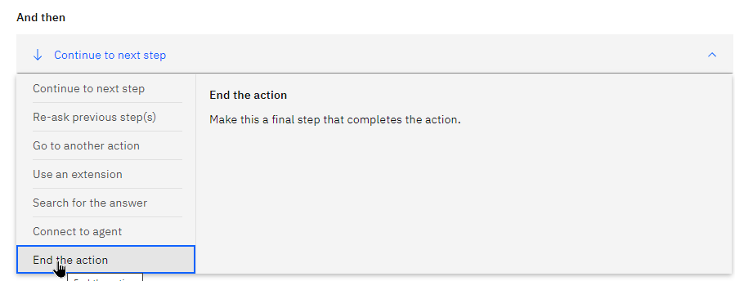
Creating a final response – Step 4 (4 of 5)
The action must end after this step is reached.
Change the “And then” setting to End the action.
Notes:
Finally, make sure that the action ends after this step is reached. Change the “And then” setting to End the action.

Slide 94
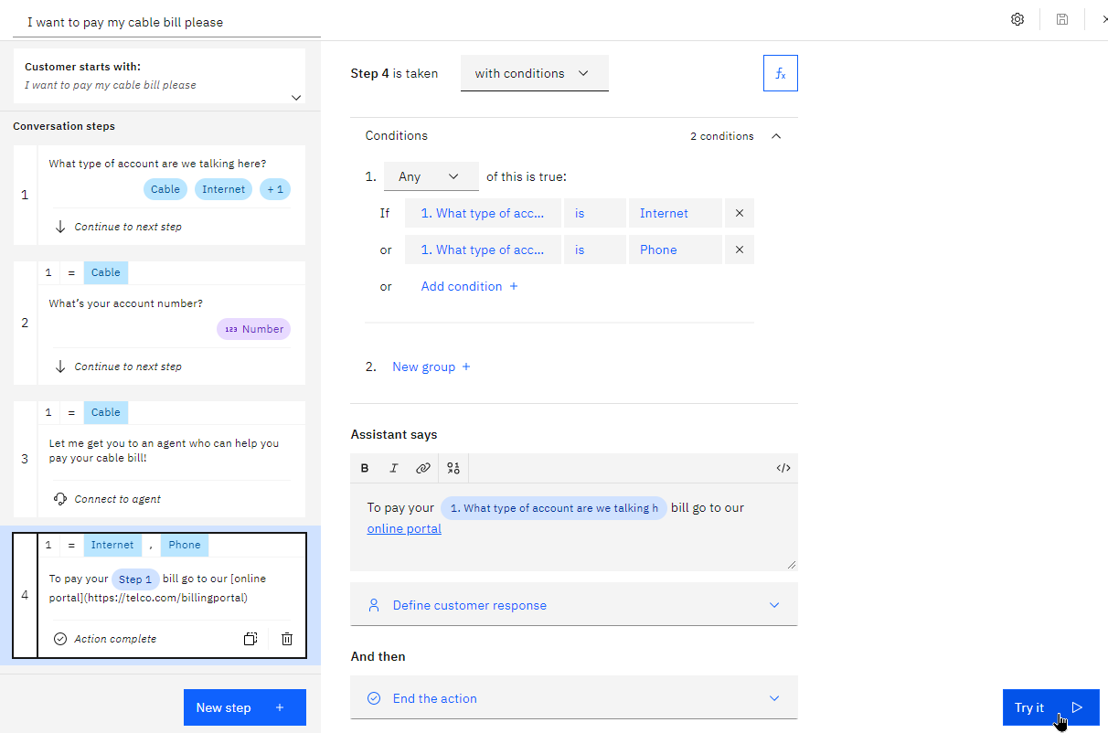
Creating a final response – Step 4 (5 of 5)
Notes:
Your steps now are completed and look like shown in the figure.
Click Try it to test a few scenarios.

Slide 95
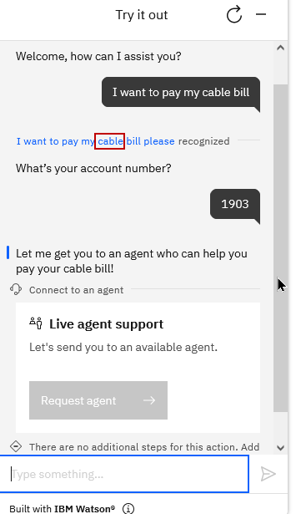


Try it out (1 of 2)
Notes:
Try a few scenarios. Notice that when you state the type of bill up front, the assistant skips the question about the type of bill and moves immediately to the next step.

Slide 96


Get a real-life preview of your assistant: Preview
Notes:
To see how your assistant would really work on one of your channels, open the preview page.
The preview page is a representation of your “draft” work in progress and has an inline preview for you to test. You can also share your work with others on your team quickly with a sharable URL

Slide 97
Classic Watson Assistant
Notes:
Classic Watson Assistant documentation https://cloud.ibm.com/docs/assistant?topic=assistant-index

Slide 98
When to use classic Watson Assistant?
Reasons for using classic Watson Assistant include:
The assistant was built before the new Watson Assistant became available in October 2021.
Your developers are familiar and comfortable with the classic experience.
You want greater control over the logic of the flow.
The dialog editor exposes more of the underlying artifacts (such as intents and entities) used to build the AI models.
The dialog flow uses an if-then-else style structure that might be familiar to developers, but not to content designers or customer-care experts.
The following features are available in dialog-based conversations but not in Actions.
Contextual entities
Detection of other system entities
Image response type
Digression support
Webhook (log all messages) support
Notes:
┌ Hint ─────────────────
Want to get started with actions, but need features that are available from a dialog? Use both. Dialog is your primary conversation with users, but you can call an action from your dialog to perform a discrete task. For more information see Calling actions from a dialog at https://cloud.ibm.com/docs/watson-assistant?topic=watson-assistant-dialog-call-action
└────────────────────
References:
Comparing actions and dialog
https://cloud.ibm.com/docs/watson-assistant?topic=watson-assistant-comparing-actions-dialog
Annotation-based method - Contextual entities
https://cloud.ibm.com/docs/assistant?topic=assistant-entities#entities-annotations-overview
Handling Watson Assistant response types
https://www.ibm.com/docs/en/voice-gateway?topic=states-handling-watson-assistant-response-types
Response type image
https://www.ibm.com/docs/en/voice-gateway?topic=states-handling-watson-assistant-response-types#wa_response_type_image
Understanding dialog skill digressions
https://cloud.ibm.com/docs/assistant?topic=assistant-tutorial-digressions
Webhook overview
https://cloud.ibm.com/docs/assistant?topic=assistant-webhook-overview

Slide 99
Components
Classic Watson Assistant main components:
Assistants
Dialog skills
Intents
Entities
Dialog
Notes:
The Watson Assistant main components are:
Assistants
Dialog skills
Intents
Entities
Dialog

Slide 100
Assistant
Assistant:
A cognitive bot that you can customize for your business needs.
A dialog is activated from the assistant settings.
The assistant can be deployed through multiple interfaces, such as:
Messaging channels, like Slack and Facebook Messenger.
A simple chat widget on a website or on an existing company web page.
A custom application, such as a mobile app or a robot with a voice interface.
Notes:
Assistants
An assistant is a cognitive bot that you can customize for your business needs and deploy across multiple channels to help your customers where and when they need it.
You customize the assistant by adding to it the skills that it needs to satisfy your customers' goals.
Activate a dialog skill that can understand and address questions or requests with which your customers typically need help. You provide information about the subjects or tasks that your users ask about and how they ask about them. Then, the service dynamically builds a machine learning model that is tailored to understand the same and similar user requests.
You can deploy the assistant through multiple interfaces, including:
Existing messaging channels, such as Slack and Facebook Messenger.
You can give your users access to the assistant through a simple chat widget that you publish to a website or add to an existing company web page.
You can design a custom application that incorporates it by making direct calls to the underlying APIs.

Slide 101
Dialog skill
Dialog skill:
Acts as a container for all of the artifacts and training data.
A skill contains the following types of artifacts:
Intents
Entities
Dialog
A skill uses the training data to build a machine learning model to recognize similar user inputs.
When you add or change the training data, the training process is triggered to ensure that the underlying model stays up to date.
Notes:
Skill
Sometimes referred to as dialog skill.
A Dialog skill acts as a container that contains the training data and logic that enables an assistant to help your customers.
It contains the following types of artifacts:
Intents
Entities
Dialog
As you add information, the data is used to build a machine learning model that can recognize these and similar user inputs. Each time that you add or change the training data, the training process is triggered to ensure that the underlying model stays up-to-date as your customer needs and the topics they want to discuss change.

Slide 102
Intent
Intent:
Represents the purpose of or goal of a user's input.
Tends to be general, such as a question about business location or a bill payment.
For intent creation:
Plan the intents for application. Define an intent for each type of user request that you want your application to support.
Teach Watson Assistant about your intents. Supply many examples of user input and indicate the intents to which they map.
In the tool, the name of an intent is always prefixed with ’#’. For example, #payment or #inquiry.
Notes:
Intent
An intent represents the purpose of a user's input, such as a question about business locations or a bill payment.
Plan the intents for an application: Consider what your customers might want to do and what you want your application to be able to handle on their behalf. For example, you might want your application to help your customers make a purchase. If so, you can add a #buy_something intent.
You define an intent for each type of user request that you want your application to support.
Teach Watson Assistant about your intents: After you decide the business requests that you want your application to handle for your customers, you must teach Watson Assistant about them. For each business goal (such as #buy_something), you must provide at least 10 examples of utterances that your customers typically use to indicate their goal. For example, “I want to make a purchase.”
Ideally, find real-world user utterance examples that you can extract from existing business processes. The user examples should be tailored to your specific business. For example, if you are an insurance company, your user examples might look more like this, “I want to buy a new XYZ insurance plan.”
To train the dialog skill to recognize your intents, supply many examples of user input and indicate to which intents they map. The examples that you provide are used by the service to build a machine learning model that can recognize the same and similar types of utterances and map them to the appropriate intent.
In the tool, the name of an intent is always prefixed with the # character.
Start with a few intents and test them as you iteratively expand the scope of the application.

Slide 103
Intent (cont.)
Intent examples:
“Good morning” -> #greeting.
“Where can I find the nearest restaurant?” -> #location_info.
“Where can I pay my electric bill?” -> #location_info.
Remember: Intents represent what the user wants to achieve: a goal, an action, or verbs.
Notes:
Intent examples:
“Good morning” -> #greeting
“Where can I find the nearest restaurant?” -> #location_info
“Where can I pay my electric bill?” -> #location_info
Remember: Intents represent what the user wants to achieve: a goal, an action, or verbs.

Slide 104
Entity
Entity
Represents a term or object that is relevant to the user’s intent and that provides a specific context for an intent.
If intents represent verbs (the action a user wants to do), entities represent nouns (the object of, or the context for that action).
By recognizing the entities that are mentioned in the user's input, the service can reply with a more targeted response or perform a required action.
In the tool, the name of an entity is always prefixed with ’@’. For example, @street or @contact_info.
Notes:
Entity
Entities represent information in the user input that is relevant to the user's purpose.
If intents represent verbs (the action a user wants to do), entities represent nouns (the object of, or the context for, that action). For example, when the intent is to get a weather forecast, the relevant location and date entities are required before the application can return an accurate forecast.
Entities represent a class of object or a data type that is relevant to a user’s purpose. By recognizing the entities that are mentioned in the user's input, the service can reply with a more targeted response or perform a required action.

Slide 105
Entity evaluation
The Assistant service looks for terms in the user input by using exact matching of values, synonyms, or patterns that are defined for the entities.
Synonym entity:
Specify a bunch of synonyms, that is, words that have exact or similar meanings.
For example, for the entity value Blue, its synonyms can be Aqua, Navy, and Cyan.
Pattern entity:
You specify a regular expression that defines the pattern for mentions.
For example, for email patterns such as name@ibm.com, the pattern can be:
\b[A-Za-z0-9._%+-]+@[A-Za-z0-9.-]+\.[A-Za-z]{2,}\b
Notes:
The Assistant service looks for terms in the user input that match the values, synonyms, or patterns that you define for the entity:
Synonym entity: Synonyms are words or phrases that mean exactly or nearly the same as the corresponding entity. You define a category of terms as an entity (color), and then one or more values in that category (blue). For each value, you specify several synonyms (aqua, navy, and cyan). At run time, the service recognizes terms in the user input that exactly match the values or synonyms that you defined for the entity as mentions of that entity.
Pattern entity: You define a category of terms as an entity (contact_info), and then define one or more values in that category (email). For each value, you specify a regular expression that defines the textual pattern of mentions of that value type. For an email entity value, you might want to specify a regular expression that defines a text@text.com pattern. This email regex example can capture all mentions of emails in their proper format. At run time, the service looks for patterns matching your regular expression in the user input, and identifies any matches as mentions of that entity.

Slide 106

Entity evaluation (cont.)
System entity: A synonym entity that is prebuilt by IBM (such as numbers, dates, or others).
Notes:
System entity: A synonym entity that is prebuilt for you by IBM. They cover commonly used categories, such as numbers, dates, and times. You simply enable a system entity to start using it.

Slide 107


Dialog
Dialog
A dialog is a branching conversation flow that defines how your application responds when it recognizes the defined intents and entities.
The dialog is made up of nodes that are chained together in a tree structure (graphically).
Each node includes conditions for the node to be active, and also an output object that defines the response that is provided.
Think of the node as an if-then construction: If this condition is true, then return this response.
User
Notes:
Dialog
A dialog is a branching conversation flow that defines how your application responds when it recognizes the defined intents and entities.
The dialog is made up of nodes that define steps in the conversation.
Dialog nodes are chained together in a tree structure (graphically).
Each node includes conditions for the node to be active, and also an output object that defines the response that is provided.
Think of the node as an if-then construction: If this condition is true, then return this response.
Condition: Specifies the information that must be present in the user input for this node in the dialog to be triggered.
Response: The utterance that the service uses to respond to the user.

Slide 108

Dialog (cont.)
Dialog (cont.)
A single node with one condition and response can handle simple user requests.
To handle more complex tasks, you can add child nodes to ask the user for additional information.
Notes:
Dialog
A single node with one condition and response can handle simple user requests.
To handle more complex tasks, you can add child nodes to ask the user for additional information.
A child node is processed after its parent node. NODE 1 is the parent node for CHILD NODE 1 and CHILD NODE 2.
Some useful definitions:
A root node is a node that does not depend on other nodes. In the example, NODE 1 is a root node.
A child node is a node that depends on another node, its parent node. The parent node is processed first, and based on that processing, the child node is either processed or not.

Slide 109
Conditions
Conditions
Logical expressions that are evaluated to true or false.
A node condition determines whether that node is used in the conversation.
Conditions usually evaluate the intents and entities that are identified in the user responses, but they can also evaluate information that is stored in the context.
Notes:
Conditions
Conditions are logical expressions that are evaluated to true or false. A node condition determines whether that node is used in the conversation or to choose among the possible responses to the user.
Conditions usually evaluate the intents and entities that are identified in the user responses, but they can also evaluate information that is stored in the context.

Slide 110

Responses
Responses:
The dialog response defines how to reply to the user.
The dialog response consists of the messages that are based on the identified intents, entities, or context that are communicated to the user when the dialog node is activated.
You can add variations to the response for a more natural experience.
Notes:
Responses
Responses are messages that are based on the identified intents and entities that are communicated to the user when the dialog node is activated. You can add variations of the response for a more natural experience or add conditions to pick one response out of many in the same dialog node.
The figure shows an example of adding different variations for greetings if the node is triggered by a greeting intent from the user.

Slide 111
Rich responses
Rich responses:
In addition to the default response type of text, you can return other interactive response types to enhance the user experience.
The following response types are supported:
Image: Embeds an image into the response.
Option: Adds a list of one or more options.
Pause: Forces the application to wait for a specified number of milliseconds before continuing with processing.
Notes:
Rich responses
In addition to the default response type of text, you can return responses with multimedia or interactive elements, such as images or clickable buttons to simplify the interaction model of your application and enhance the user experience.
The following response types are supported:
Image: Embeds an image into the response.
Option: Adds a list of one or more options. When a user clicks one of the options, an associated user input value is sent to the service. How options are rendered can differ depending on where you deploy the dialog. For example, in one integration channel, the options might be displayed as clickable buttons, but in another they might be displayed as a drop-down list.
Pause: Forces the application to wait for a specified number of milliseconds before continuing with processing. You can choose to show an indicator that the dialog is working on typing a response. Use this response type if you need to perform an action that might take some time.

Slide 112

Multiple (conditional) responses
Multiple (conditional) responses
In a single dialog node, you can provide different responses, each one triggered by a different condition. Use this approach to address multiple scenarios in a single node.
Example: The service uses information that it collected earlier about the user's location to tailor its response and provide information about the store nearest the user.
Notes:
In a single dialog node, you can provide different responses, each one triggered by a different condition. Use this approach to address multiple scenarios in a single node.
In this example, the service uses information that it collected earlier about the user's location to tailor its response and provide information about the store nearest the user. The conditional responses are based on context values.
This single node now provides the equivalent function of four separate nodes.

Slide 113

Watson Assistant dialog features (cont.)
Slots
Add slots to a dialog node to gather multiple pieces of information from a user within that node.
Slots collect information at the user’s pace. Details that the user provides are saved, and the service asks only for the details that the user did not provide.
Example: User-provided values for multiple slots in one input.
Notes:
Slots
Add slots to a dialog node to gather multiple pieces of information from a user within that node. Slots collect information at the users' pace. Details that the user provides are saved, and the service asks only for the details the use did not provide.
Example:
The user wants to reserve a table in a restaurant. The needed information is the number of guests, the date, the time, and the name of the restaurant. When asked, the user might provide values for multiple slots at once. For example, the input might include the information, ”There will be 6 of us dining at 7 PM”. This one input contains two of the missing required values: the number of guests and time of the reservation. The service recognizes and stores both of them, each one in its corresponding slot. It then displays the prompt that is associated with the next empty slot, which in this case asks the user, “Where would you like to eat?” to determine the restaurant slot and stores the response. After the user replies, the service asks, “What day will this take place?” to determine the date slot, stores it, and gives a reply.

Slide 114

Dialog flow
Dialog flow
The dialog standard flow is processed from top to bottom and left to right.
Triggered by a successful condition.
It ends when it reaches the last node in the branch that it is following.
User input
Match
Notes:
The dialog is processed by the service from top to bottom.
As it travels down the tree, if the service finds a condition that is met, it triggers that node. It then moves from left to right on the triggered node to check the user input against any child node conditions. As it checks the children nodes, it moves again from top to bottom.
The service continues to work its way through the dialog tree until it reaches the last node in the branch that it is following.
If none of the conditions evaluates to true, then the response from the last node in the tree, which typically has a special anything_else condition that always evaluates to true, is returned.
When you start to build the dialog, you must determine the branches to include and where to place them. The order of the branches is important because nodes are evaluated from first to last. The first node whose condition matches the input is used; any nodes that come later in the tree are not triggered.

Slide 115

Watson Assistant components (cont.)
Dialog depiction
Notes:
Dialog depiction
This diagram shows a mockup of a dialog tree that is built with the GUI dialog builder tool. It contains two root dialog nodes. A typical dialog tree would likely have many more nodes, but this depiction provides a glimpse of what a subset of nodes might look like.
The first root node has conditions for an intent value. It has two child nodes and each have a condition on an entity value. The second child node defines two responses. The first response is returned to the user if the value of the context variable matches the value that is specified in the condition. Otherwise, the second response is returned.
This standard type of node is useful to capture questions about a certain topic and then in the root response ask a follow-up question that is addressed by the child nodes. For example, it might recognize a user question about discounts and ask a follow-up question about whether the user is a member of any associations with which the company has special discount arrangements. The child nodes provide different responses based on the user's answer to the question about association membership.
The second root node is a node with slots. It also has conditions on an intent value. It defines a set of slots, one for each piece of information that you want to collect from the user. Each slot asks a question to elicit the answer from the user. It looks for a specific entity value in the user's reply to the prompt, which it then saves in a slot context variable.
This type of node is useful for collecting details that you might need to perform a transaction on the user's behalf. For example, if the user's intent is to book a flight, the slots can collect the origin and destination location information, travel dates, and so on.

Slide 116


Switching the experience
You can switch back and forth between the new experience and the classic experience.
To switch between the new and classic experiences, following these steps:
From the Watson Assistant interface, click the Manage icon to open your account menu.
Select Switch to classic experience or Switch to new experience from the account menu.
Notes:
You can easily switch back and forth between the new experience and the classic experience. However, the new experience provides a simplified user interface, an improved deployment process, and access to the latest features.
To switch between the new and classic experiences, following these steps:
From the Watson Assistant interface, click the Manage icon to open your account menu.
Select Switch to classic experience or Switch to new experience from the account menu.
You don’t lose any work if you switch to a different experience, and other users of the same instance are not affected. However, keep in mind that any work you do in one experience is not available in the other experience. You can switch back and forth at any time.
References:
Switching the experience
https://cloud.ibm.com/docs/watson-assistant#welcome-new-assistant-switch-experience
Switching between new and classic experiences
https://cloud.ibm.com/docs/watson-assistant?topic=watson-assistant-switch-experience

Slide 117
Migrating to the new experience

Slide 118
Deciding which experience to use
If you are using a Watson Assistance instance that you created before October 2021 , you might still be using the classic Watson Assistant experience.
Consider the following questions to decide which experience you want to use:
Do you want to build a new actions-based assistant?
The new experience provides a simplified user interface that was designed around actions, and an improved deployment process
Are you working on an existing assistant built in the classic Watson Assistant?
If you have a dialog-based assistant, consider migrating it to the new experience so you can take advantage of the new process for publishing and deploying your assistant.
Do you want to convert an existing dialog-based assistant to use actions?
If you have a dialog-based assistant, but you want to reimplement it to use actions instead, start by migrating it to the new experience. You can then start to use actions alongside your dialog, and you can replace your dialog nodes with actions at your own pace.
Notes:
If you are using a Watson Assistance instance that you created before October 2021, you might still be using the classic Watson Assistant experience. To take advantage of the latest features, consider switching to the new experience.
Consider the following questions to decide which experience you want to use:
Do you want to build a new actions-based assistant?
The new experience provides a simplified user interface that was designed around actions, and an improved deployment process. If you plan to build an actions-based assistant, use the new experience for access to the latest features and improvements.
Are you working on an existing assistant built in the classic Watson Assistant?
If you have a dialog-based assistant that was built by using the classic Watson Assistant, and you are not currently planning to migrate to an actions-based assistant, you might still want to consider migrating it to the new experience so you can take advantage of the new process for publishing and deploying your assistant. Migrating to the new experience also makes it easy for you to begin using actions when you are ready.
For more information about how to migrate a dialog-based assistant to the new experience, see Activating dialog and migrating skills at https://cloud.ibm.com/docs/watson-assistant?topic=watson-assistant-activate-dialog
Do you want to convert an existing dialog-based assistant to use actions?
If you have a dialog-based assistant, but you want to reimplement it to use actions instead, start by migrating it to the new experience. You can then start to use actions alongside your dialog, and you can replace your dialog nodes with actions at your own pace.
For more information about using a dialog with actions, see Calling actions from a dialog at https://cloud.ibm.com/docs/watson-assistant?topic=watson-assistant-dialog-call-action
References:
Migrating to the new experience
https://cloud.ibm.com/docs/watson-assistant?topic=watson-assistant-migrate-overview
New Watson Assistant - Deployment process overview
https://cloud.ibm.com/docs/watson-assistant?topic=watson-assistant-publish-overview
Activating dialog and migrating skills
https://cloud.ibm.com/docs/watson-assistant?topic=watson-assistant-activate-dialog
Calling actions from a dialog
https://cloud.ibm.com/docs/watson-assistant?topic=watson-assistant-dialog-call-action

Slide 119
Migrating intents and entities
You can migrate your intents and entities from the classic Watson Assistant experience to the new Watson Assistant experience.
In the new experience, intents are known as example phrases in an action
In the new experience, entities are known as saved customer responses.
Downloading intents
You can download an intent to a CSV file, so you can then upload and reuse the examples as example phrases in the new Watson Assistant experience.
Downloading entities
You can download entities to a CSV file, so you can then upload and reuse them as saved customer responses in the new Watson Assistant experience.
Notes:
Downloading intents
You can download an intent to a CSV file, so you can then upload and reuse the examples as example phrases in the new Watson Assistant experience.
Go to the Intents page.
Select the intent that you want to download, and then click the Download icon .
Specify the name and location in which to store the CSV file that is generated, and then click Save.
Upload the examples from the intent as example phrases for a specific action in the new Watson Assistant.
For more information, see Uploading phrases https://cloud.ibm.com/docs/watson-assistant?topic=watson-assistant-understand-questions#understand-questions-uploading-examples
Downloading entities
You can download a number of entities to a CSV file, so you can then upload and reuse them as saved customer responses in the new Watson Assistant experience.
Go to the Entities page.
Select the entities that you want to download, and then click the Download icon .
Specify the name and location in which to store the CSV file that is generated, and then click Save.
Upload the entities as saved customer responses in the new Watson Assistant. For more information, see Uploading saved customer responses at https://cloud.ibm.com/docs/watson-assistant?topic=watson-assistant-collect-info#uploading-saved-customer-response
References:
Migrating intents and entities
https://cloud.ibm.com/docs/watson-assistant?topic=watson-assistant-migrate-intents-entities
Uploading phrases
https://cloud.ibm.com/docs/watson-assistant?topic=watson-assistant-understand-questions#understand-questions-uploading-examples
Uploading saved customer responses
https://cloud.ibm.com/docs/watson-assistant?topic=watson-assistant-collect-info#uploading-saved-customer-response

Slide 120


Activating dialog
To use an existing dialog skill, activate the dialog feature in your assistant.
To activate the dialog feature in the new experience:
Create or open an assistant where you want to use a dialog as the primary conversation with users.
Open Assistant settings.
Click Activate dialog.
In the confirmation that displays, click Activate dialog again.
Notes:
To use an existing dialog skill, activate the dialog feature in your assistant. Then, you can upload your existing skill.
Activating dialog
To activate the dialog feature in the new experience:
Create or open an assistant where you want to use a dialog as the primary conversation with users.
Open Assistant settings.
Click Activate dialog.
In the confirmation that displays, click Activate dialog again.
References:
Activating dialog and migrating skills
https://cloud.ibm.com/docs/watson-assistant?topic=watson-assistant-activate-dialog
Downloading a skill
https://cloud.ibm.com/docs/assistant?topic=assistant-skill-tasks#skill-tasks-download

Slide 121

Migrating skills
Once the dialog feature is activated, you can start a new dialog conversation from scratch. Or if you have an existing dialog skill, you can migrate it to the new Watson Assistant.
To migrate an existing dialog skill:
Use the classic experience to download your dialog skill in JSON format.
In the new Watson Assistant, open the Dialog page.
In Options, choose Upload / Download.
On the Upload tab, upload the JSON file for your dialog skill.
Notes:
Migrating existing skills
Once the dialog feature is activated, you can start a new dialog conversation from scratch. Or if you have an existing dialog skill, you can migrate it to the new Watson Assistant.
To migrate an existing dialog skill:
Use the classic experience to download your dialog skill in JSON format.
In the new Watson Assistant, open the Dialog page.
In Options, choose Upload / Download.
On the Upload tab, upload the JSON file for your dialog skill.
References:
Downloading a skill
https://cloud.ibm.com/docs/assistant?topic=assistant-skill-tasks#skill-tasks-download
Migrating existing skills
https://cloud.ibm.com/docs/watson-assistant?topic=watson-assistant-activate-dialog#activate-dialog-upload

Slide 122
Calling actions from a dialog
In the new Watson Assistant, you can use actions with your primary dialog conversation.
A dialog takes precedence over actions.
You can use actions to supplement a dialog-based conversation, but the dialog drives the conversation with users to match their requests.
A dialog node calls an action to perform a task and then return to the dialog. From a single dialog node, you can make a call to either a webhook or an action, not both.
Choose the approach that best suits your needs:
Call an action if you want to perform a discrete and self-contained task, and then return to the dialog to be ready to address any new user requests.
Data that is collected from the user during action processing must be stored as a session variable for it to be passed to the dialog.
Call a webhook if you want to send a request to a web service to complete a task and return a response that can be used later by this dialog.
Notes:
In the new Watson Assistant, you can use actions with your primary dialog conversation. A dialog feature takes precedence over actions. You can use actions to supplement a dialog-based conversation, but the dialog drives the conversation with users to match their requests.
A dialog node calls an action to perform a task and then return to the dialog. From a single dialog node, you can make a call to either a webhook or an action, not both. Choose the approach that best suits your needs:
Call an action if you want to perform a discrete and self-contained task, and then return to the dialog to be ready to address any new user requests. Data that is collected from the user during action processing must be stored as a session variable for it to be passed to the dialog.
Call a webhook if you want to send a request to a web service to complete a task and return a response that can be used later by this dialog. For more information, see Extending your assistant with webhooks.
┌ Note ─────────────────
For step-by-step instructions, see “Adding a call to an action” at https://cloud.ibm.com/docs/watson-assistant?topic=watson-assistant-dialog-call-action#dialog-call-action-add
└────────────────────
References:
Calling actions from a dialog
https://cloud.ibm.com/docs/watson-assistant?topic=watson-assistant-dialog-call-action
Extending your assistant with webhooks
https://cloud.ibm.com/docs/watson-assistant?topic=watson-assistant-webhook-overview
Adding a call to an action
https://cloud.ibm.com/docs/watson-assistant?topic=watson-assistant-dialog-call-action#dialog-call-action-add

Slide 123
When to call an action from a dialog
You might want to call an action from a dialog in the following scenarios:
You want to perform an action from multiple dialog threads.
For example, you want to ask customers how satisfied they are with your service. You can define a single action to check customer satisfaction and call it from multiple branch-ending dialog nodes.
You want to see how actions works.
In this scenario, you can pick an intent for the action to handle. If you plan for the action to be called from the dialog only, you can define the user examples for the intent that triggers the dialog node.
┌ Note ─────────────────
For step-by-step instructions, see “Adding a call to an action” at https://cloud.ibm.com/docs/watson-assistant?topic=watson-assistant-dialog-call-action#dialog-call-action-add
└────────────────────
Notes:
You might want to call an action from a dialog in the following scenarios:
You want to perform an action from multiple dialog threads.
For example, you want to ask customers how satisfied they are with your service. You can define a single action to check customer satisfaction and call it from multiple branch-ending dialog nodes.
In this scenario, you don't need to define an intent, such as #check_satisfaction. The action is called automatically, replacing a jump to another dialog node's response.
You want to see how actions works.
In this scenario, you can pick an intent for the action to handle. If you plan for the action to be called from the dialog only, you can define the user examples for the intent that triggers the dialog node. When you define the action, you can add one customer example only, reducing the time that you need to spend building the action.
┌ Note ─────────────────
For step-by-step instructions, see “Adding a call to an action” at https://cloud.ibm.com/docs/watson-assistant?topic=watson-assistant-dialog-call-action#dialog-call-action-add
└────────────────────
References:
Calling actions from a dialog
https://cloud.ibm.com/docs/watson-assistant?topic=watson-assistant-dialog-call-action
Extending your assistant with webhooks
https://cloud.ibm.com/docs/watson-assistant?topic=watson-assistant-webhook-overview
Adding a call to an action
https://cloud.ibm.com/docs/watson-assistant?topic=watson-assistant-dialog-call-action#dialog-call-action-add

Slide 124
Enriching the chatbot

Slide 125
Persona
Creating a persona for your bot makes the bot friendlier and engages its users.
You can create a bot persona by adding some distinguishing characteristics to your chatbot.
Avatar: A face for your chatbot. A simple 2D graphic image, or even a 3D figure adds a nice touch, along with a name.
Adding a gender is not always a good idea. Generally, the chatbot should be gender-neutral, such as a friendly android (robot) or a friendly pet like a cat or a bird.
A voice: Makes a chatbot more interactive and adds value to its personality.
Easy to implement because of the many available text to speech services.
Notes:
Although it might be clear to the user that they are talking to a chatbot, creating a persona makes the bot friendlier and engages its users. You can create a bot persona by providing some distinguishing characteristics to your chatbot. For example, adding the following features can help to accomplish this goal:
Avatar An avatar adds a face to your chatbot. A simple 2D graphic image adds a nice touch, along with a name. Adding a gender is not always a good idea. Generally, the chatbot should be gender-neutral, such as a friendly android (robot) or a friendly pet like a cat or a bird.
A voice Adding a voice to your chatbot makes it more interactive and adds value to its personality. Doing so requires almost no effort because most text to speech services can be added to your existing output response text to transform it into audio.

Slide 126
Emotion and tone
Sentiment analysis can map user emotion input to a positive, negative, or neutral status.
Your chatbot can then sense the user’s positive comment and react to it, or sense a negative input and direct the conversation appropriately.
Tone analysis can perform more advanced interpretation of the user’s mood.
For example, it can detect whether the user is frustrated or thankful. The chatbot can then reply with a customized answer to each mood, giving your bot emotional AI that adds to its personality and makes it friendlier.
Notes:
Sentiment analysis can map user emotion input to a positive, negative, or neutral status. It adds emotion to your chatbot. Your chatbot can sense the user’s positive comment and react to it, or sense a negative input and direct the conversation appropriately.
Tone analysis can perform more advanced interpretation of the user’s mood. For example, it can detect whether the user is frustrated or thankful. The chatbot can then reply with a customized answer to each mood, giving your bot emotional AI that adds to its personality and makes it friendlier.

Slide 127

Integrations page
The page is organized into three sections:
Essential channels. The foundations of any assistant’s ability to reach users. They are web chat and phone.
Extensions. Customize your assistant by adding Search capabilities and connecting to third-party APIs with the Build custom extensions option.
Channels. Deploy your assistant to Slack, Facebook Messenger and SMS/WhatsApp with Twilio.
Notes:
For your assistant to reach its potential as a comprehensive user solution, it needs to seamlessly call out to and pull information from a wide variety of web apps.
Managing all the possible channels, integrations, and extensions might seem daunting task, but Watson Assistant simplifies the process with its Integrations page. The “Integrations” page consolidates all of your channels, extensions, and third-party connections in one spot, streamlining your ability to manage how and where users interact with your assistant.
To open the Integrations page, click the Integrations icon in the Watson Assistant home page.
The page is organized into three sections:
Essential channels. The foundations of any assistant’s ability to reach users. They are web chat and phone.
Extensions. Customize your assistant by adding Search capabilities and connecting to third-party APIs with the Build custom extensions option.
Channels. Deploy your assistant to Slack, Facebook Messenger and SMS/WhatsApp with Twilio.
References:
Watson Assistant Integrations: channel your knowledge
https://medium.com/ibm-watson/watson-assistant-integrations-channel-your-knowledge-909dfecae26
Adding integrations
https://cloud.ibm.com/docs/watson-assistant?topic=watson-assistant-deploy-integration-add

Slide 128

Integrations: Essential channels
The most common methods of deploying assistants.
Web chat is a code snippet that you can immediately embed in your company’s website.
Phone integration makes your assistant available to customers over the phone.
Notes:
Essential channels constitute the foundations of any assistant’s ability to reach users. They are web chat and phone. They are the most common methods of deploying assistants.
Web chat is a code snippet that you can immediately embed in your website.
When you build a custom user interface for your assistant, you spend a lot of time and effort writing code to solve typical UI problems. For example, you must keep up with browser support changes, manage scrolling behavior, validate input, and design the layout and styling. The time that you spend designing and maintaining the UI can be better spent building a quality assistant instead. When you use the web chat integration, Watson Assistant manages the user interface, so you can focus on designing conversational exchanges that address the unique business needs of your customers.
Phone integration. By adding the phone integration to your assistant, you can make your assistant available to customers over the phone. When you add the phone integration to your assistant, you can automatically generate a working phone number that is automatically connected to your assistant. Or, if you prefer, you can connect the assistant to your existing infrastructure by configuring an existing Session Initiation Protocol (SIP) trunk.
When your customer makes a phone call by using the telephone number connected to your assistant, the phone integration answers. The integration converts output from your assistant into voice audio by using the IBM Watson Text to Speech service. The audio is sent to the telephone network through the SIP trunk. When the customer replies, the voice input is converted into text by using the IBM Watson Speech to Text service.
┌ Note ─────────────────
Phone integration is available only to Plus or Enterprise plan users.
└────────────────────
References:
Web chat overview
https://cloud.ibm.com/docs/assistant?topic=assistant-web-chat-basics
Integrating the web chat with your website
https://cloud.ibm.com/docs/assistant?topic=assistant-deploy-web-chat
Integrating with phone
https://cloud.ibm.com/docs/assistant?topic=assistant-deploy-phone

Slide 129

Integrations: Extensions
Add features or content to your assistant custom or pre-built extensions.
Requires an OpenAPI document (formerly known as Swagger), which is an open standard for describing and documenting REST APIs.
Search integration gives your assistant access to corporate data collections that it can mine for answers (Plus plan).
Notes:
If you need to integrate your assistant with an external service that has a REST API, you can build a custom extension by importing an OpenAPI document (previously known as Swagger).
After you create a custom extension, you can connect it to an assistant as an integration. In your actions, you can then define steps that interact with the external service by calling the extension.
For more information about connecting a custom extension to an assistant, see Add a custom extension at https://cloud.ibm.com/docs/watson-assistant?topic=watson-assistant-add-custom-extension.
You can put your subject matter expertise to work by adding search. The search integration gives your assistant access to corporate data collections that it can mine for answers.
When a search integration is added, your assistant can route complex customer inquiries to the IBM Watson Discovery service. Discovery treats the user input as a search query. It finds information that is relevant to the query from an external data source and returns it to the assistant. With search integration, the assistant can query existing company documents or data to see whether any useful information can be found and shared with the customer.
┌ Note ─────────────────
Search integration is available only to Plus or Enterprise plan users.
└────────────────────
References:
Add a custom extension
https://cloud.ibm.com/docs/watson-assistant?topic=watson-assistant-add-custom-extension
OpenAPI Specification
https://swagger.io/specification/
Watson Assistant Extensions Starter Kit
https://github.com/watson-developer-cloud/assistant-toolkit/tree/master/integrations/extensions
Adding a search integration
https://cloud.ibm.com/docs/watson-assistant?topic=watson-assistant-search-add

Slide 130

Integrations: Channels
Deploy your assistant to third-party channels to expand your reach.
Messaging with you assistant through messaging apps:
Facebook Messenger
Slack
SMS with Twilio
WhatsApp with Twilio
Notes:
The final section of the “Integrations” page contains quick links to configure your assistant for deployment to four of the most widely used digital messaging apps:
Facebook Messenger
Slack
SMS with Twilio
WhatsApp with Twilio
By using an existing account with these services, you can make your assistant available through these apps in a matter of minutes.
References:
Adding integrations
https://cloud.ibm.com/docs/watson-assistant?topic=watson-assistant-deploy-integration-add
Watson Assistant Integrations: channel your knowledge
https://medium.com/ibm-watson/watson-assistant-integrations-channel-your-knowledge-909dfecae26

Slide 131
Speech recognition
You can use IBM, Google, and Microsoft speech to text services to enable your chatbot to understand user speech.
This feature is heavily used in home automation chatbots and automation tasks in general.
For example, in Microsoft Windows you can give commands to Cortana by using your voice without touching a key or pressing a mouse button. You can do the same with Siri on the Apple iPhone.
Notes:
With advancements in speech to text technology, you can use IBM, Google, and Microsoft speech to text services to enable your chatbot to understand user speech.
This feature is heavily used in home automation chatbots and automation tasks in general. For example, in Microsoft Windows you can give commands to Cortana by using your voice without touching a key or pressing a mouse button. You can do the same with Siri on the Apple iPhone.

Slide 132
Thanks
Any questions?

